Slide 1

Transforming DNA Evidence into Reliable Information:
Computers, Science and Society
Pathology Informatics Summit
Association for Pathology Informatics
May, 2017
Pittsburgh, PA
Mark W Perlin, PhD, MD, PhD
Cybergenetics, Pittsburgh, PA
Cybergenetics © 2003-2017

Slide 2
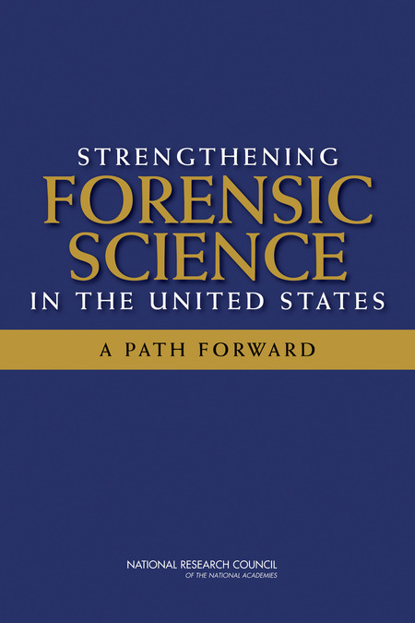
National Academy of Sciences
Trouble in River City
2009
Where’s the “science” in Forensic Science?

Slide 3
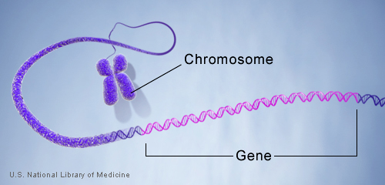
DNA genotype
A genetic locus has
two DNA sentences,
one from each parent.
An allele is the number
of repeated words.
locus
A genotype at a locus
is a pair of alleles.
mother
allele
1
2
3
4
5
6
7
8
9
10
10, 12
ACGT
repeated word
Many alleles allow for
many many allele pairs.
A person's genotype
is relatively unique.
father
allele
1
2
3
4
5
6
7
8
9
10
11
12

Slide 4
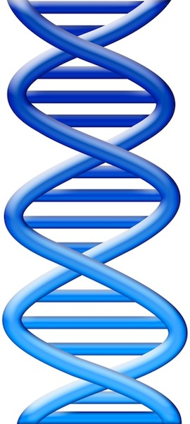
Simple DNA interpretation
Evidence item
Lab
Evidence data
Infer
Evidence genotype
10, 12
10 11 12
DNA from
one person
Compare
Known genotype
10, 12

Slide 5
Pittsburgh skyline

Slide 6
Draw a threshold
1990

Slide 7
Same heights & vacant lots

Slide 8
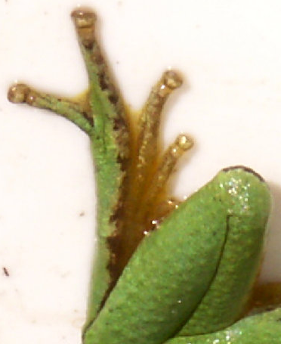
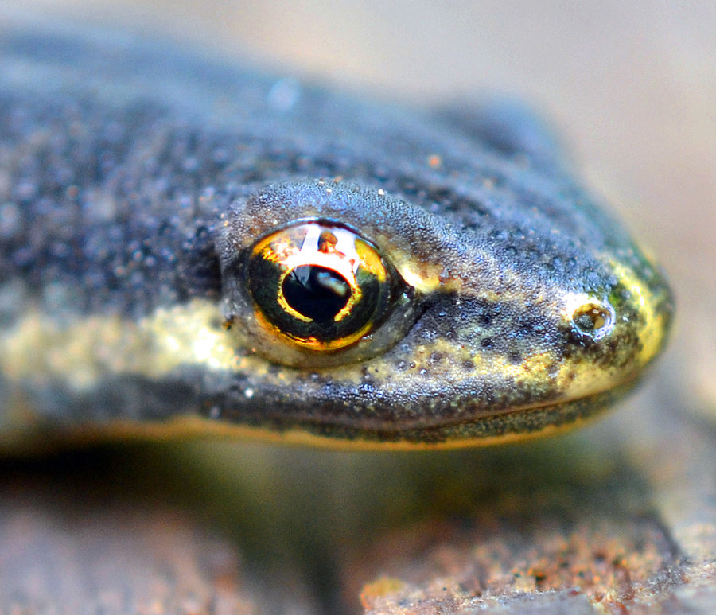

DNA mixture
1995
eye of newt
toe of frog
Double, double toil and trouble

Slide 9
Simplify data to interpret mixture
2000
f₁
f₂
f₃
f₄
f₅
Apply threshold to find “alleles”
Add allele frequencies (f₁ + f₂ + …)
Square sum, take reciprocal
Locus “probability of inclusion” (PI)
Multiply locus PI values
Combined (CPI) match statistic

Slide 10
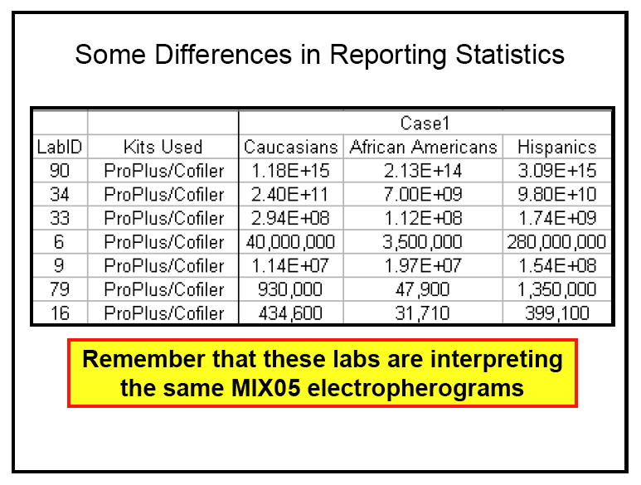
Unreliable DNA mixture statistics
2005
NIST (Commerce Department) study in 2005
Two contributor mixture data, known victim
When not
“inconclusive”:
213 trillion (14)
31 thousand (4)
Forensic DNA labs put on notice ten years ago

Slide 11




Biased DNA workflow
2010
(1)
Choose data
(3)
Person decides
(2)
Calculate statistic
• Put people in the process
• To overcome software limits
• And introduce human bias

Slide 12
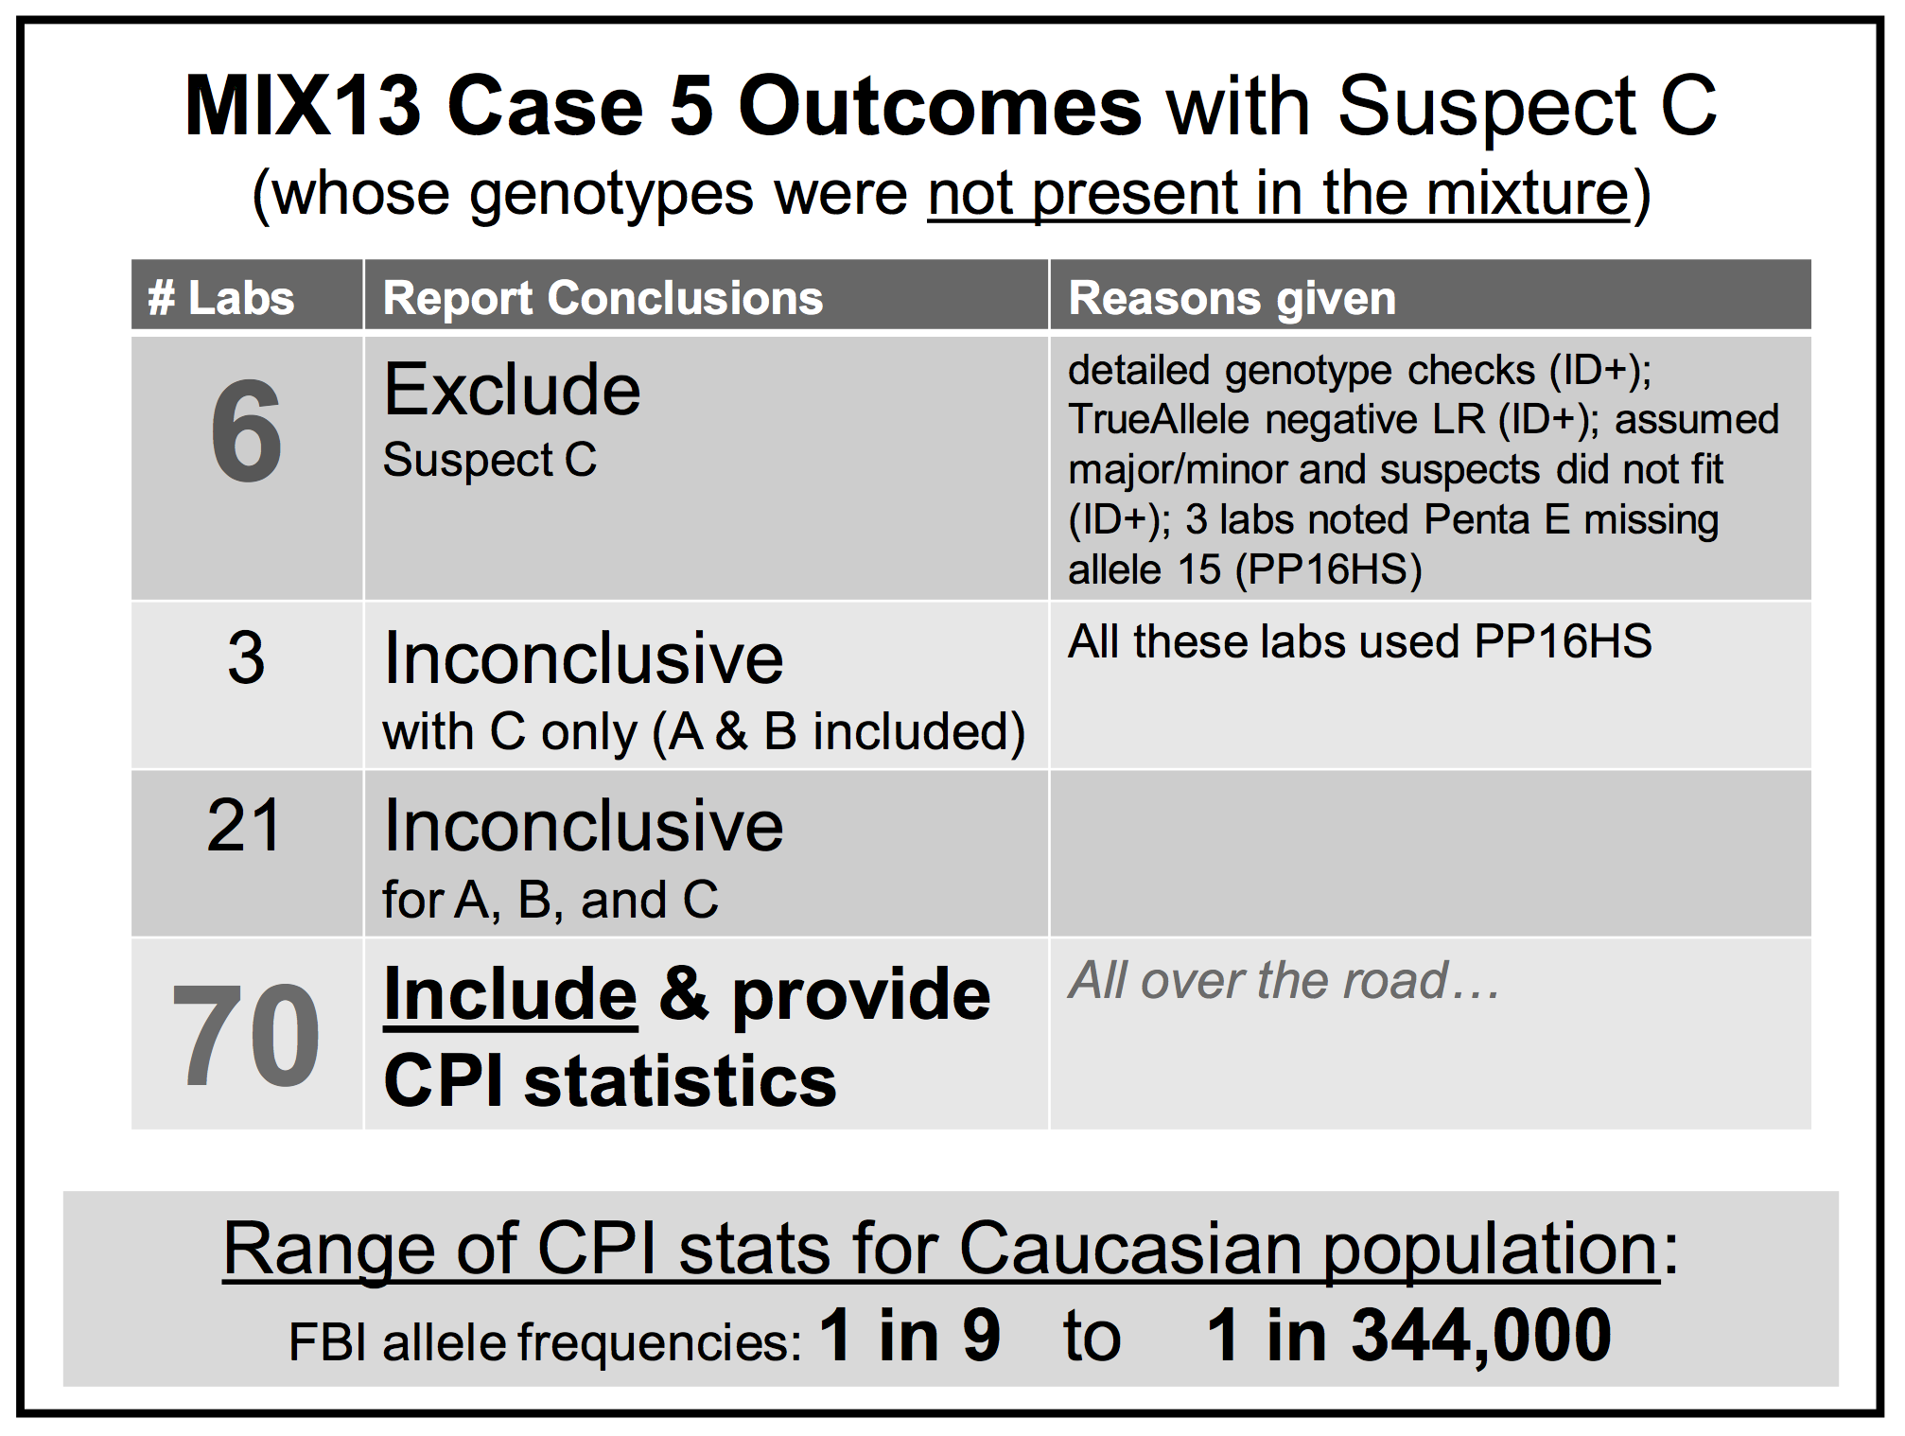
Falsely identify innocent people
2015

Slide 13
Mixture statistics shut down labs
“National accreditation board suspends all DNA testing at D.C. crime lab”
The Washington Post April 27, 2015
Did not comply with FBI standards
“New protocol leads to reviews of
‘mixed DNA’ evidence”
The Texas Tribune September 12, 2015
24,468 lab tests affected

Slide 14
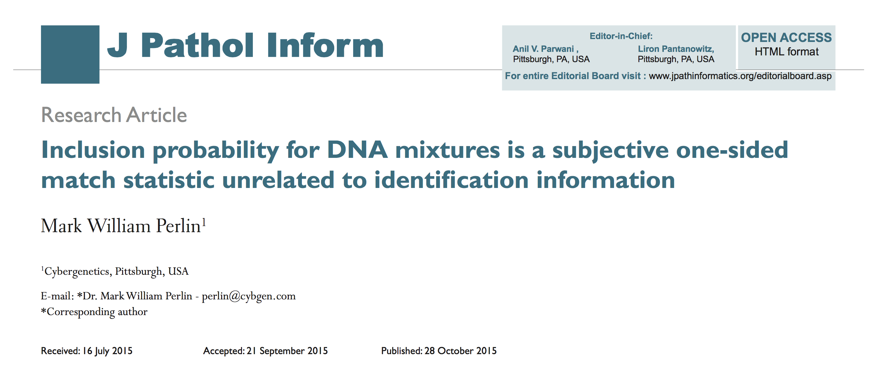
Statistics lack scientific basis
Misled courts for 15 years on countless DNA mixtures

Slide 15
CPI is always a million

Slide 16
Average information is zero

Slide 17
Uncorrelated with information

Slide 18
Inclusion just counts tests
One-sided Match Statistic
Truncated Normal Distribution
Positive Tail Centered at Zero
Uncorrelated with Identification Information
Inclusion Distribution Has a Positive Mean
Law of Large Numbers
Why CPI is Always a Million
A subjective one-sided match statistic unrelated to identification information

Slide 19
TrueAllele® computer technology
• Accurate. 34 validation studies, 7 published
• Objective. Workflow removes human bias
• Accepted. Reported in 37 states, used by labs
• Transparent. Give math, software (4GB DVD)
• Neutral. Can statistically include or exclude

Slide 20
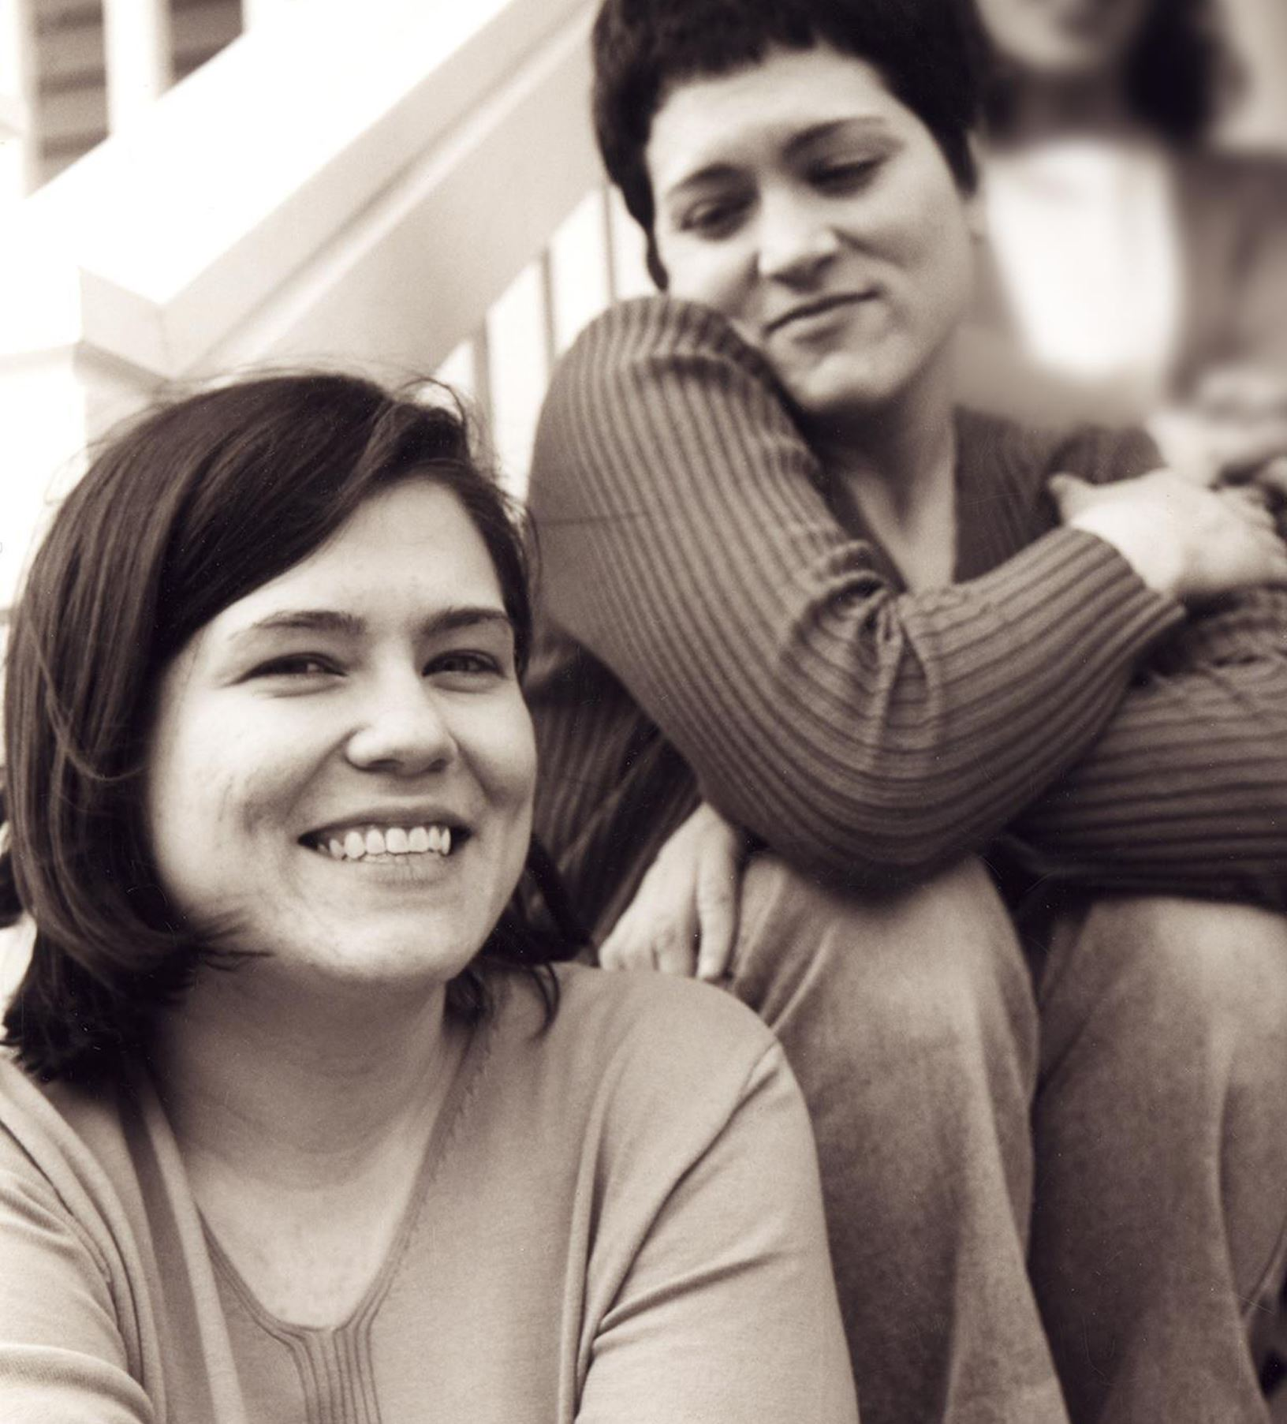
Wolfe sisters homicide
On February 6, 2014, Susan Wolfe (44)
and her younger sister Sarah (38, left)
were killed in their East Liberty home in Pittsburgh.

Slide 21
Pennsylvania v. Allen Wade
Thresholds failed to interpret most DNA mixtures
Hat No conclusions
Cup Insufficient data
Fingernails Contamination, insufficient data
Gear shift Insufficient data
Seat lever Cannot be excluded
Knit hat Insufficient data
Sock Too complex, no conclusions

Slide 22
Pennsylvania v. Allen Wade
The crime lab reported 5 DNA mixture matches
TrueAllele found 17 matches on the same data
Hat 65.3 thousand Allen Wade
Cup 20.5 thousand Susan Wolfe
Fingernails 6.06 trillion Allen Wade
Gear shift 9.37 million Sarah Wolfe
Seat lever 385 billion Sarah Wolfe
Knit hat 25.7 thousand Allen Wade
Sock 300 Sarah Wolfe

Slide 23
Allen Wade Found Guilty On All Counts In East Liberty Sisters’ Slaying
CBS News, May 23, 2016
PITTSBURGH (KDKA/AP)
• A man accused of killing two sisters who lived next door to him in East Liberty has been found guilty on all counts.
• Allen Wade was accused of shooting Sarah and Susan Wolfe after they returned from work on Feb. 6, 2014, apparently to steal a bank card.
• On Monday morning, a jury found Wade guilty of first-degree murder, robbery, burglary and theft by unlawful taking.

Slide 24
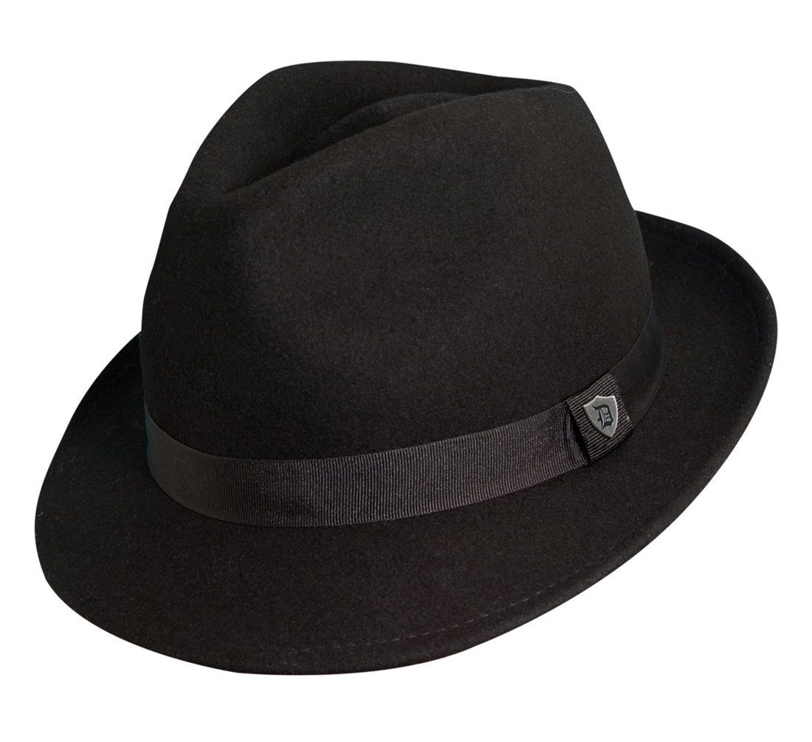
Pennsylvania v. Allen Wade
Thresholds failed to interpret DNA mixture
TrueAllele succeeded on the same data
A hat left from a burglary of the Wolfe sister’s home
six weeks before the murder matched
Allen Wade with a 65.3 thousand statistic
Preventable Crime

Slide 25
Allegheny County: 59 cases, 13 trials, 4 exonerations
Crime | Evidence | Defendant | Outcome | Sentence
rape | clothing | Ralph Skundrich | guilty | 75 years
murder | gun, hat | Leland Davis | guilty | 23 years
rape | clothing | Akaninyene Akan | guilty | 32 years
murder | shotgun shells | James Yeckel, Jr. | guilty plea | 25 years
murder | fingernail | Anthony Morgan | guilty | life
weapons | gun | Thomas Doswell | guilty plea | 1 year
bank robbery | clothing | Jesse Lumberger | guilty | 10 years
drugs | gun | Derek McKissick | guilty plea | 2 1/2 years
drugs | gun | Steve Morgan | guilty plea | 2 1/2 years
murder | door, clothing | Calvin Kane | guilty plea | 20 years
murder | fingernail, clothing | Allen Wade | guilty | life
murder | gun | Jaykwaan Pinckney | guilty plea | 10 years
child rape | clothing | Dhaque Jones | guilty plea | 6 years
shooting | gun | Anthony Jefferson | guilty plea | 4 years
weapons | gun | Zachary Blair | guilty plea | 15 years
weapons | gun | Delmingo Williams | guilty plea | 3 years
incest rape | clothing | Terry L. | guilty | 40 years
bank robbery | hat | Robert Schatzman | guilty | 1 1/2 years
weapons | gun | Rashawn Walker | guilty | 1.5 years
robbery | hat | Lauren Peak | guilty plea | 1 year
rape | body cavity | Freddie Cole | guilty plea | 2 years
murder | gun | Chaz White | guilty plea | 4 years
sex crime | clothing | Christopher Stavish | guilty plea | 2 1/2 years
murder | gun | Jake Knight | guilty | life

Slide 26
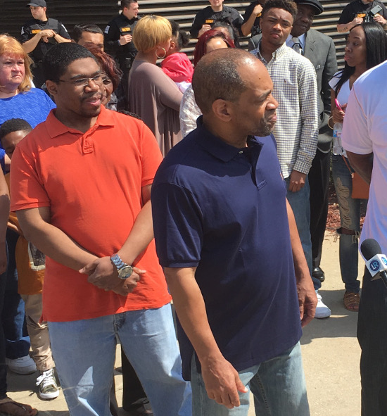
Darryl Pinkins exonerated
Indiana
April 25, 2016

Slide 27
Recommendations
Open DNA to public scrutiny
Revisit all past DNA mixture cases
Educate trial attorneys and judges
Fully automate mixture interpretation
Extensively validate DNA interpretation
Keep methods within their limits
Go beyond laboratory limits

Slide 28
Non-governmental organization
1. Reanalyze forgotten DNA evidence
2. Educate lawyers, scientists & society

Slide 29


More information
http://www.cybgen.com/information
• Courses
• Newsletters
• Newsroom
• Presentations
• Publications
• Webinars
http://www.youtube.com/user/TrueAllele
TrueAllele YouTube channel
perlin@cybgen.com

