Slide 1


Finding truth in evidence:
Computational intelligence
1
National Courts and Sciences Institute
Kansas City, Missouri
October 2024
Mark W Perlin, PhD, MD, PhD
Pittsburgh, PA USA
Cybergenetics © 2003-2024

Slide 2
New York v John Wakefield
2
In April, 2010, Brett Wentworth (41) was found dead
in his apartment, strangled with an electric guitar cord.
The police collected biological evidence was from amp cord
sections, plus his shirt collar and forearm.
The New York State Police lab examined the DNA mixtures.
Comparing the evidence with suspect Wakefield’s profile
found very little DNA match information.

Slide 3
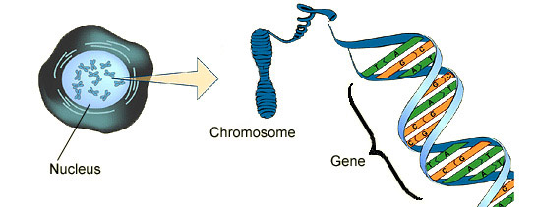
DNA biology
3
Cell
Chromosome
Locus
Nucleus

Slide 4

Short tandem repeat
4
DNA locus paragraph
Take me out to the ball game
take me out with the crowd
buy me some peanuts and Cracker Jack
I don't care if I never get back
let me
root root root root root root root root root root
for the home team,
if they don't win, it's a shame for it's one, two, three strikes, you're out
at the old ball game
23 volumes in cell's
DNA encyclopedia
"root" repeated 10 times, so
allele length is 10 repeats

Slide 5
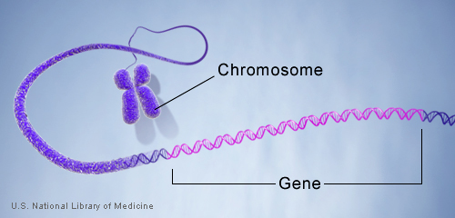
DNA genotype
5
A genetic locus has
two DNA sentences,
one from each parent.
An allele is the number
of repeated words.
locus
A genotype at a locus
is a pair of alleles.
mother
allele
1
2
3
4
5
6
7
8
9
10
10, 12
ACGT
repeated word
Many alleles allow for
many many allele pairs.
A person's genotype
is relatively unique.
father
allele
1
2
3
4
5
6
7
8
9
10
11
12

Slide 6
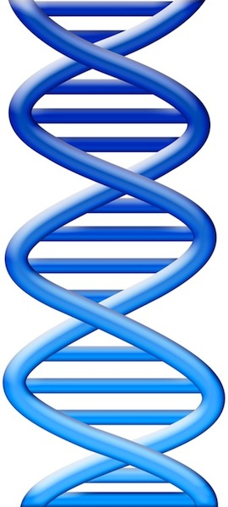
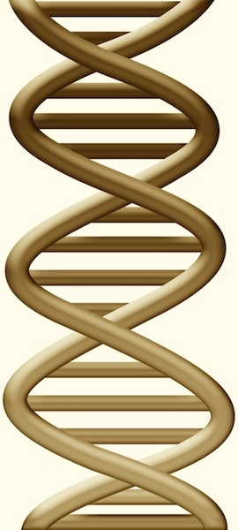
DNA evidence interpretation
6
Evidence item
Lab
Evidence data
Infer
Evidence genotype
10, 12 @ 50%
11, 12 @ 30%
12, 12 @ 20%
10 11 12
Compare
Known genotype
10, 12

Slide 7
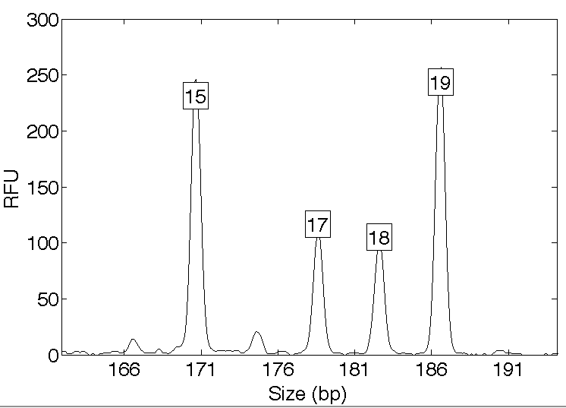
Computers can use all the data
7
Quantitative peak heights at locus vWA
peak size
peak
height

Slide 8
People may use less of the data
8
Over threshold, peaks are labeled as allele events
Threshold
All-or-none allele peaks,
each given equal status
Under threshold, alleles vanish

Slide 9
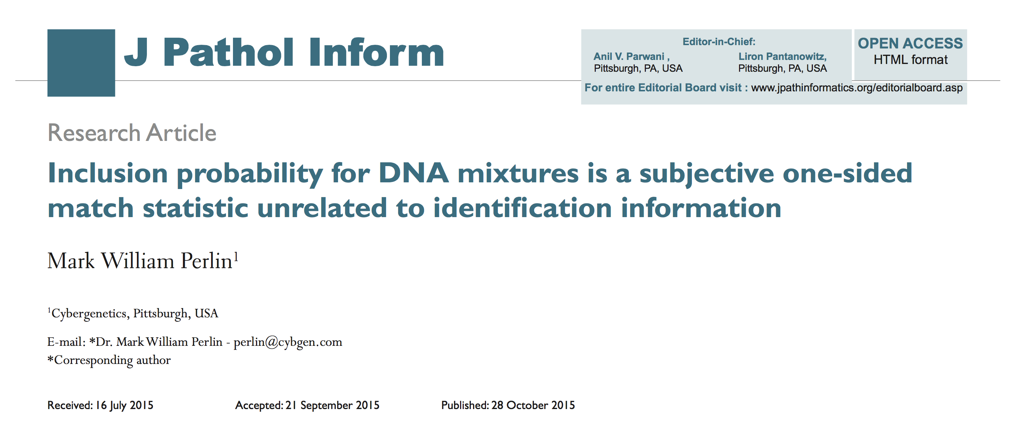
Human review CPI match statistic: subjective, biased & uninformative
9

Slide 10
Finding truth through science
10

Slide 11
How the computer thinks
11
Consider every possible genotype solution
One person’s allele pair
Explain the
peak pattern
Another person's allele pair
Better
explanation
has a higher
likelihood

Slide 12
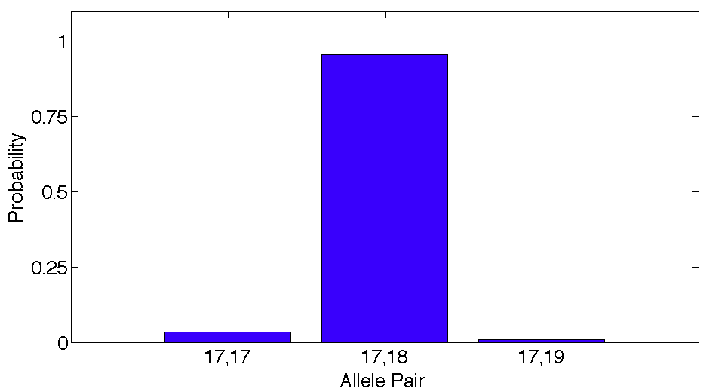
Evidence genotype
12
Objective genotype determined solely from the DNA data.
Never sees a comparison reference.
96%
3%
1%

Slide 13
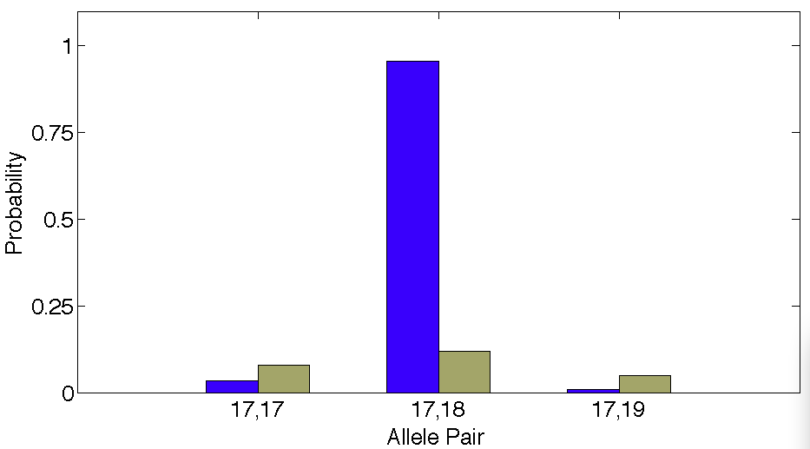
DNA match information
13
How much more does the suspect match the evidence
than a random person?
8x
96%
Prob(evidence match)
Prob(coincidental match)
12%

Slide 14
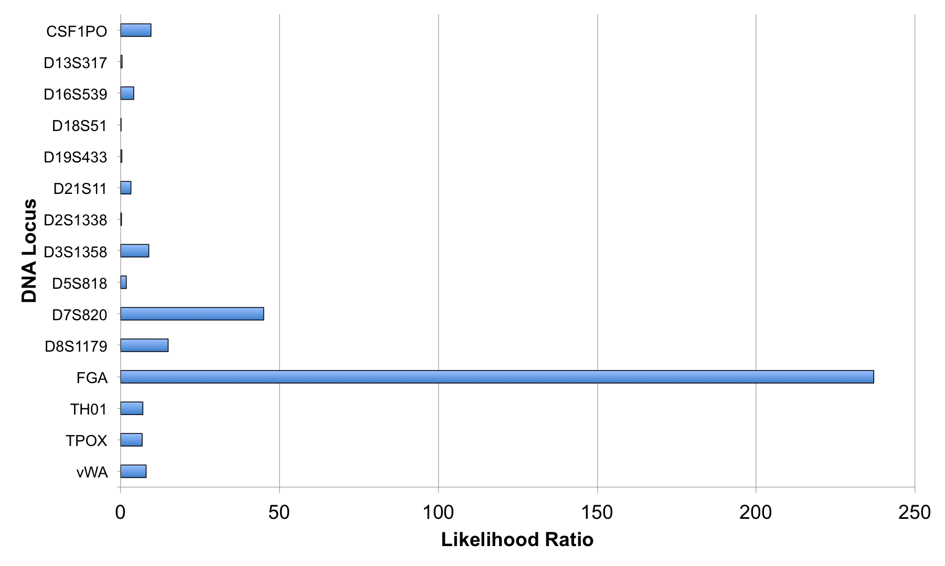
Match information at 15 loci
14

Slide 15
Is the suspect in the evidence?
15
A match between the amp cord
and John Wakefield is:
5.88 billion times more probable than
a coincidental match to an unrelated Black person
300 million times more probable than
a coincidental match to an unrelated Caucasian person
2.25 billion times more probable than
a coincidental match to an unrelated Hispanic person

Slide 16
Is the victim in the evidence?
16
A match between the amp cord
and Brett Wentworth is:
221 quintillion times more probable than
a coincidental match to an unrelated Black person
478 quadrillion times more probable than
a coincidental match to an unrelated Caucasian person
906 quadrillion times more probable than
a coincidental match to an unrelated Hispanic person

Slide 17
Match statistics
17

Slide 18
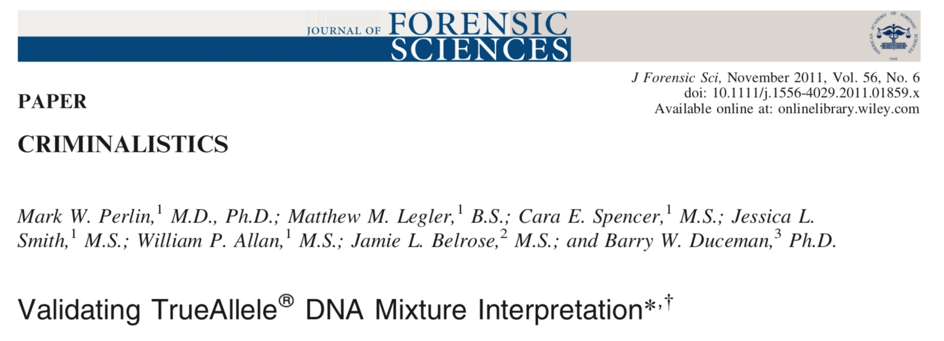
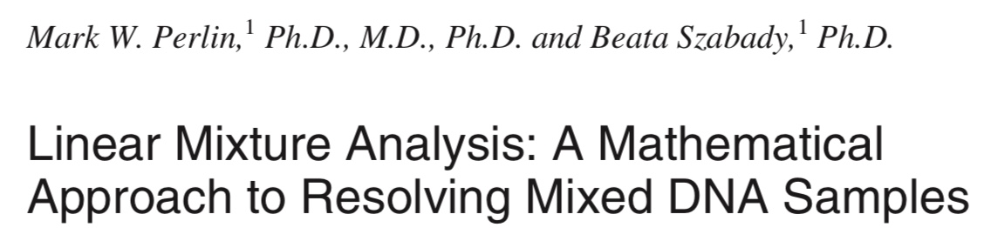
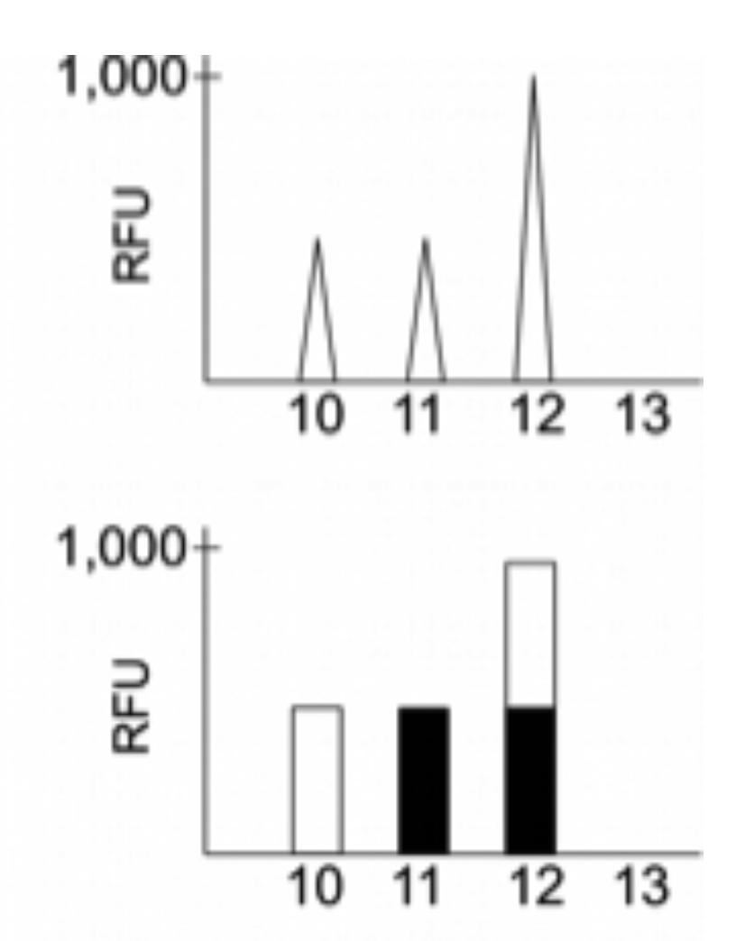
Explaining DNA mixtures
2001
DNA peak height data
Sum of genotypes

Slide 19
TrueAllele® computer solution
• Accurate. 43 validation studies, 8 published
• Objective. Workflow removes human bias
• Accepted. Reported in 46 states, used by 10 labs
• Transparent. Give math, software (4GB DVD)
• Neutral. Can statistically include or exclude

Slide 20
Peer-reviewed validation studies
20
Perlin MW, Sinelnikov A. An information gap in DNA evidence interpretation. PLoS ONE. 2009;4(12):e8327.
Ballantyne J, Hanson EK, Perlin MW. DNA mixture genotyping by probabilistic computer interpretation of binomially-sampled laser captured cell populations: Combining quantitative data for greater identification information. Science & Justice. 2013;53(2):103-114.
Perlin MW, Hornyak J, Sugimoto G, Miller K. TrueAllele® genotype identification on DNA mixtures containing up to five unknown contributors. Journal of Forensic Sciences. 2015;60(4):857-868.
Greenspoon SA, Schiermeier-Wood L, Jenkins BC. Establishing the limits of TrueAllele® Casework: a validation study. Journal of Forensic Sciences. 2015;60(5):1263-1276.
Bauer DW, Butt N, Hornyak JM, Perlin MW. Validating TrueAllele® interpretation of DNA mixtures containing up to ten unknown contributors. Journal of Forensic Sciences. 2020; 65(2):380-398.
Perlin MW, Legler MM, Spencer CE, Smith JL, Allan WP, Belrose JL, Duceman BW. Validating TrueAllele® DNA mixture interpretation. Journal of Forensic Sciences. 2011;56(6):1430-1447.
Perlin MW, Belrose JL, Duceman BW. New York State TrueAllele® Casework validation study. Journal of Forensic Sciences. 2013;58(6):1458-1466.
Perlin MW, Dormer K, Hornyak J, Schiermeier-Wood L, Greenspoon S. TrueAllele® Casework on Virginia DNA mixture evidence: computer and manual interpretation in 72 reported criminal cases. PLOS ONE. 2014;(9)3:e92837.

Slide 21
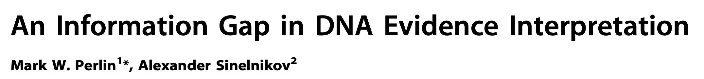

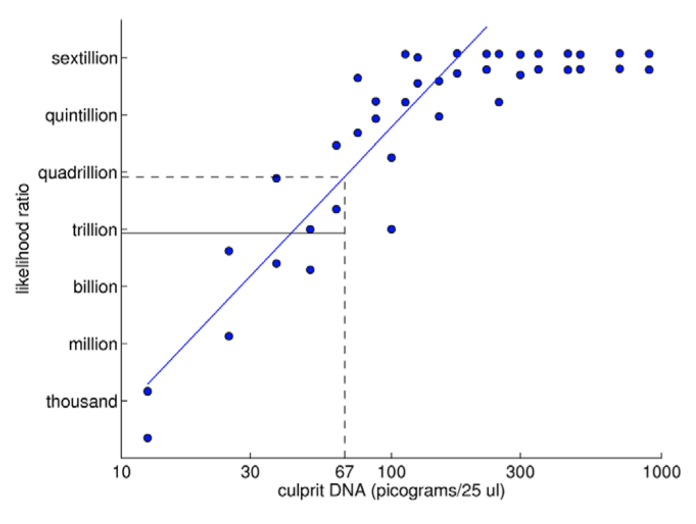
TrueAllele predictability
2009

Slide 22
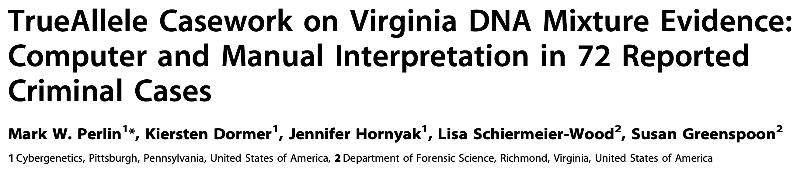
TrueAllele reliability
2014
Validation axes
• sensitive
• specific
• reproducible

Slide 23
Sensitivity
23
The extent to which interpretation identifies the correct person
True DNA mixture inclusions
101 reported genotype matches
82 with DNA statistic over a million

Slide 24
TrueAllele sensitivity
24
log(LR) match distribution
11.05 (5.42)
113 billion
TrueAllele

Slide 25
Comparison with human review
25
6.83 (2.22)
6.68 million
CPI
2.15 (1.68)
140
mCPI
11.05 (5.42)
113 billion
TrueAllele

Slide 26
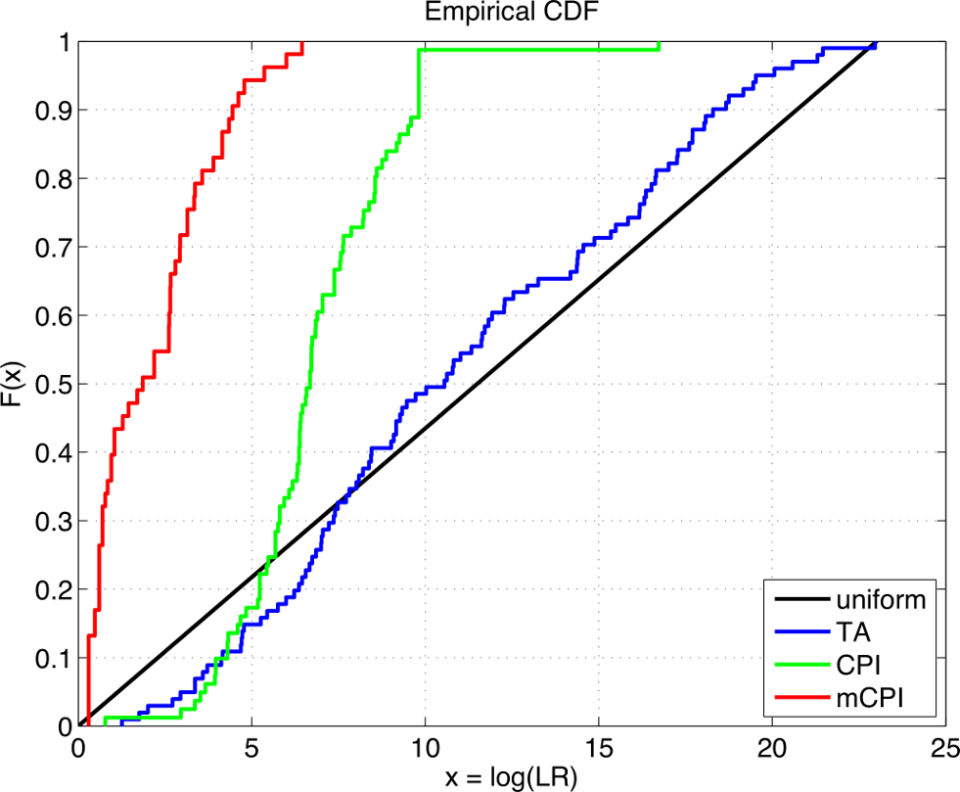
TrueAllele accuracy
26

Slide 27
Specificity
27
The extent to which interpretation does not misidentify the wrong person
True exclusions, without false inclusions
101 matching genotypes x 10,000 random references
x 3 ethnic populations,
for over 1,000,000 nonmatching comparisons

Slide 28
TrueAllele specificity
28
log(LR) nonmatch distribution
– 19.47

Slide 29
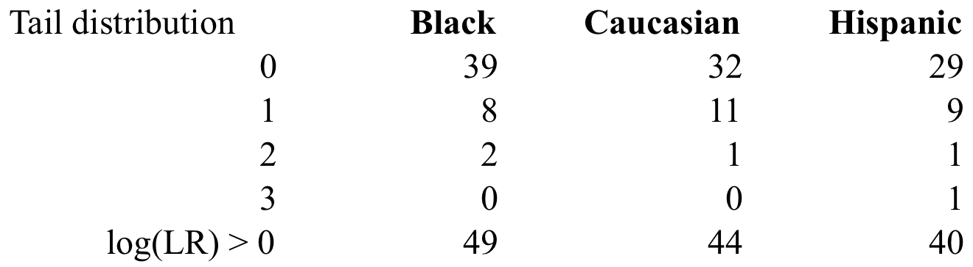
False positives
29
in over 1,000,000 comparisons per group
false positive rate is under 1 in 20,000 (0.005%)
for LR > 100, rate is 1 in 1,000,000 (0.0001)%

Slide 30
Higher human error rate
30
TrueAllele specificity (million samples)
From noncontributor distribution, for LR > 100:
Error rate = 1 in 1,000,000 (0.0001)%
CPI – analytical threshold
5 false positives in 81 comparisons
Error rate = 5 in 81 (6%)
mCPI – stochastic threshold
17 inconclusive results
1 false positive in 53 comparisons
Error rate = 1 in 53 (2%)

Slide 31
Reproducibility
31
The extent to which interpretation gives
the same answer to the same question
MCMC computing has sampling variation
duplicate computer runs
on 101 matching genotypes
measure log(LR) variation

Slide 32
TrueAllele reproducibility
32
Concordance in two independent computer runs
standard deviation
(within-group)
0.305

Slide 33
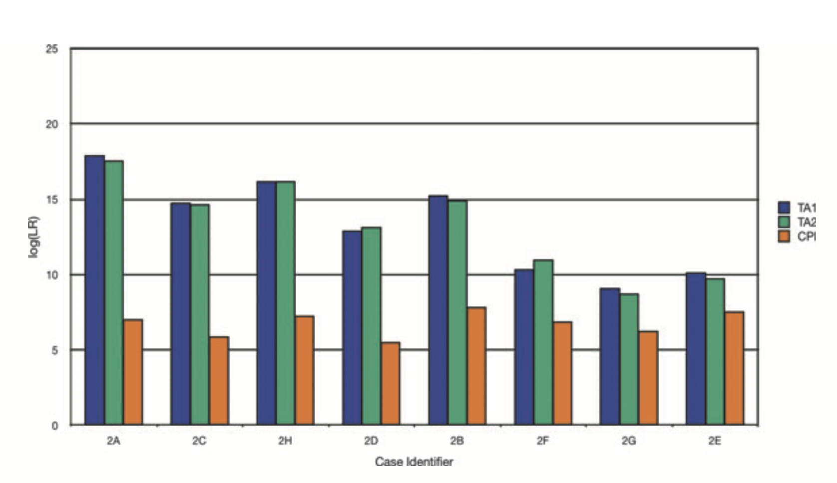

Slide 34
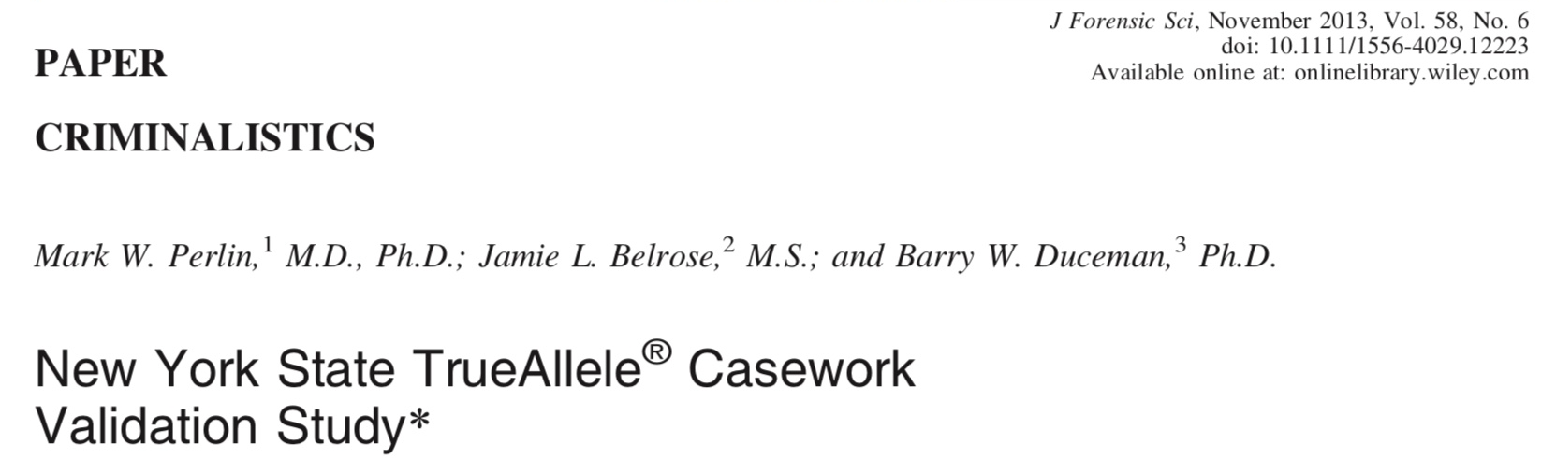
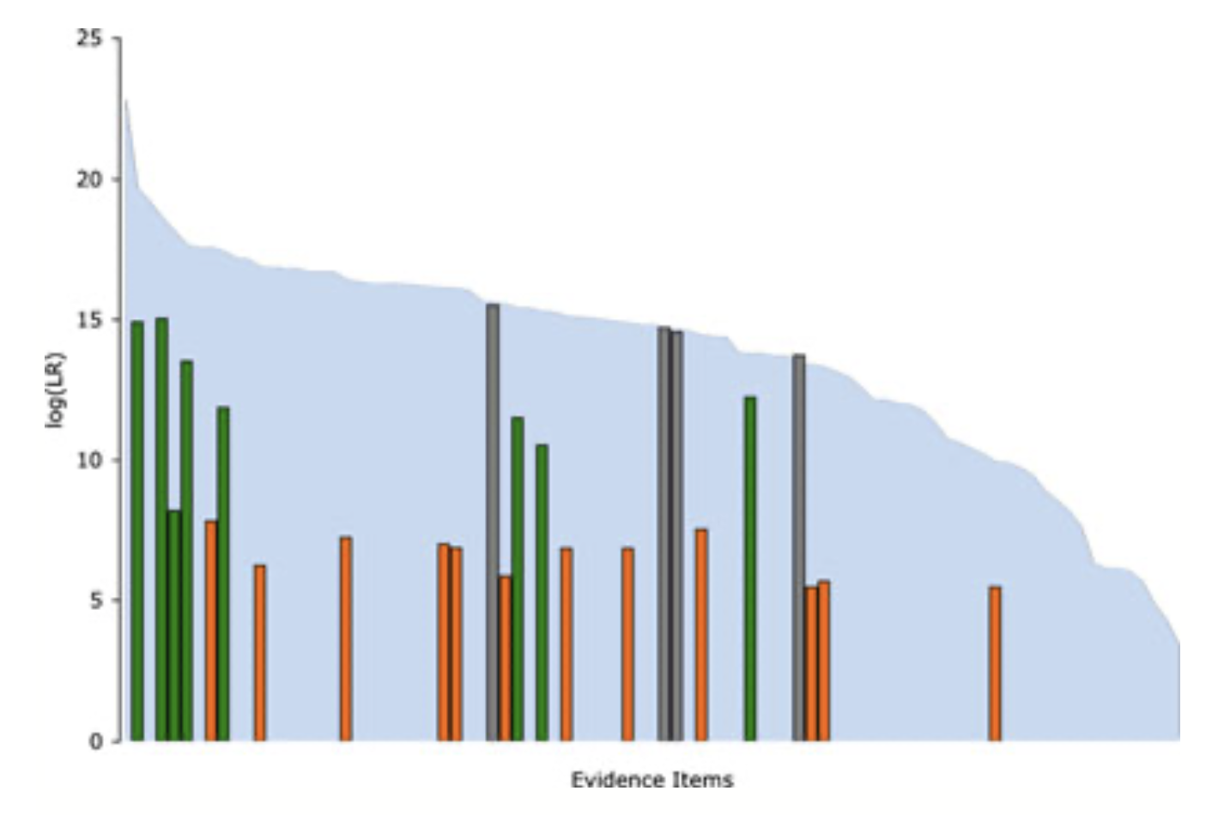

Slide 35
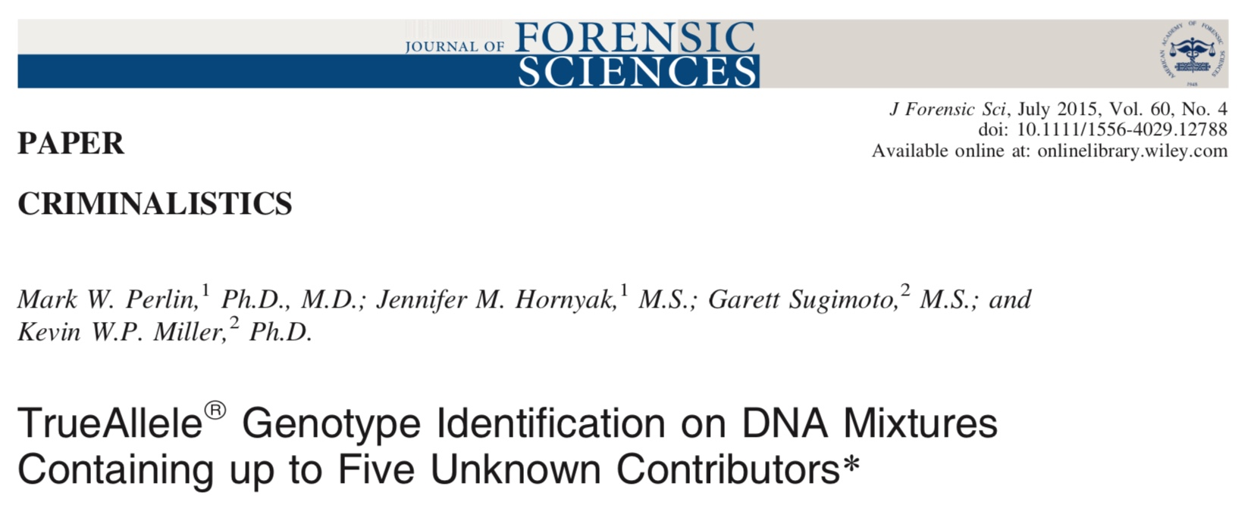
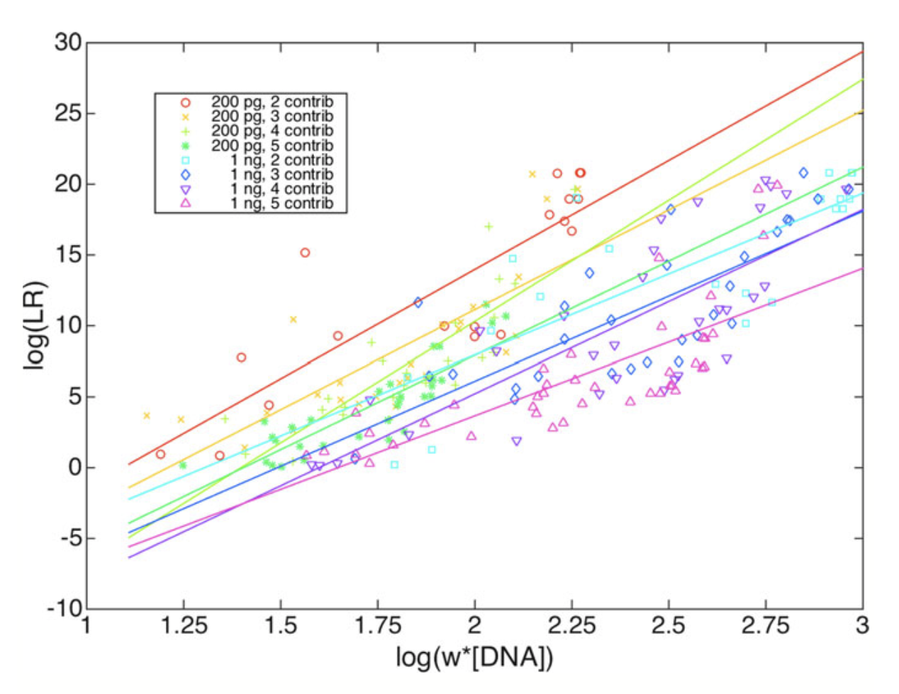

Slide 36
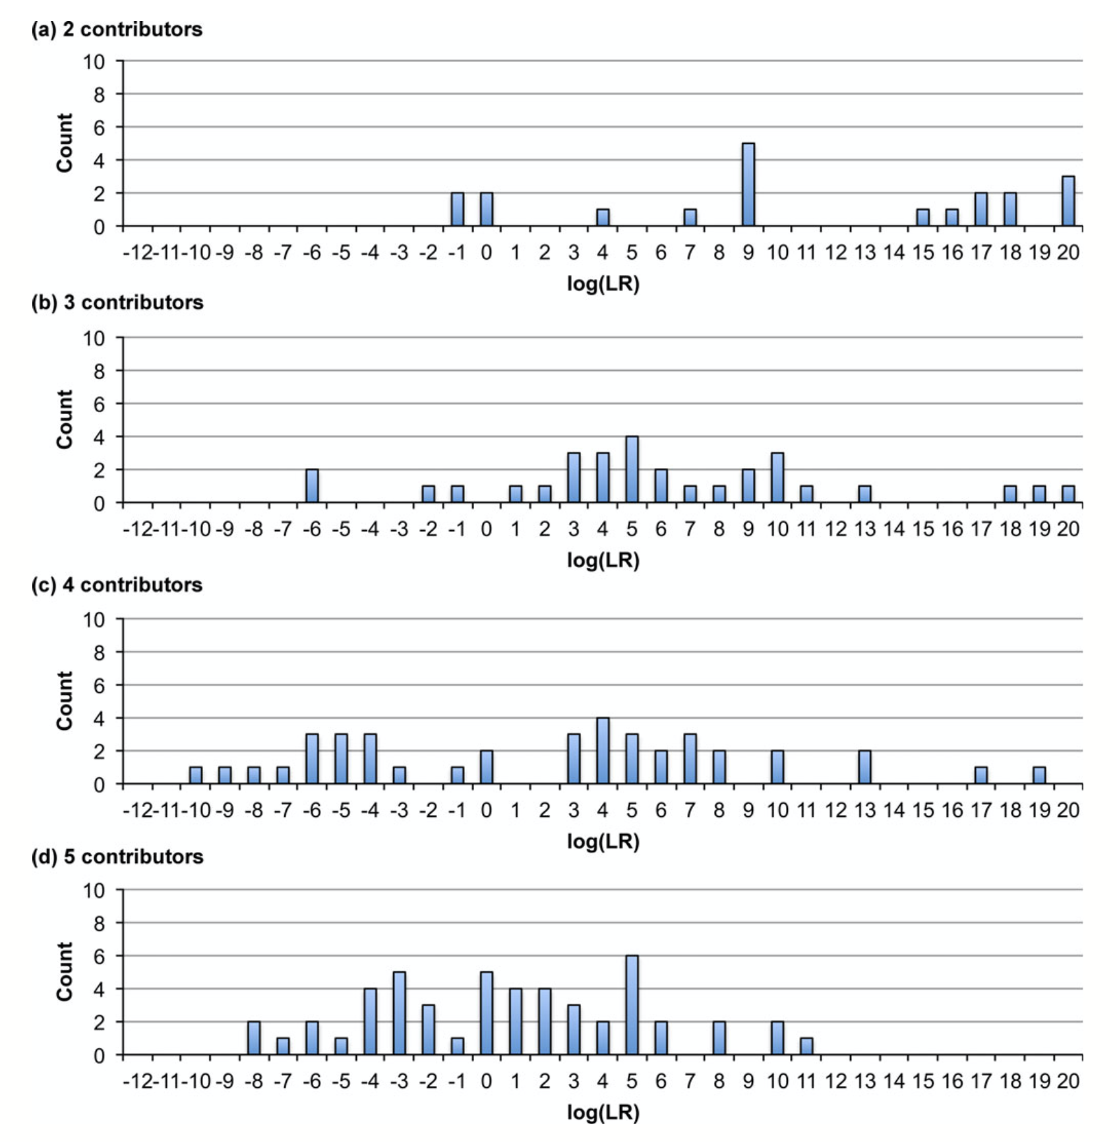
TrueAllele sensitivity
36
200 pg

Slide 37
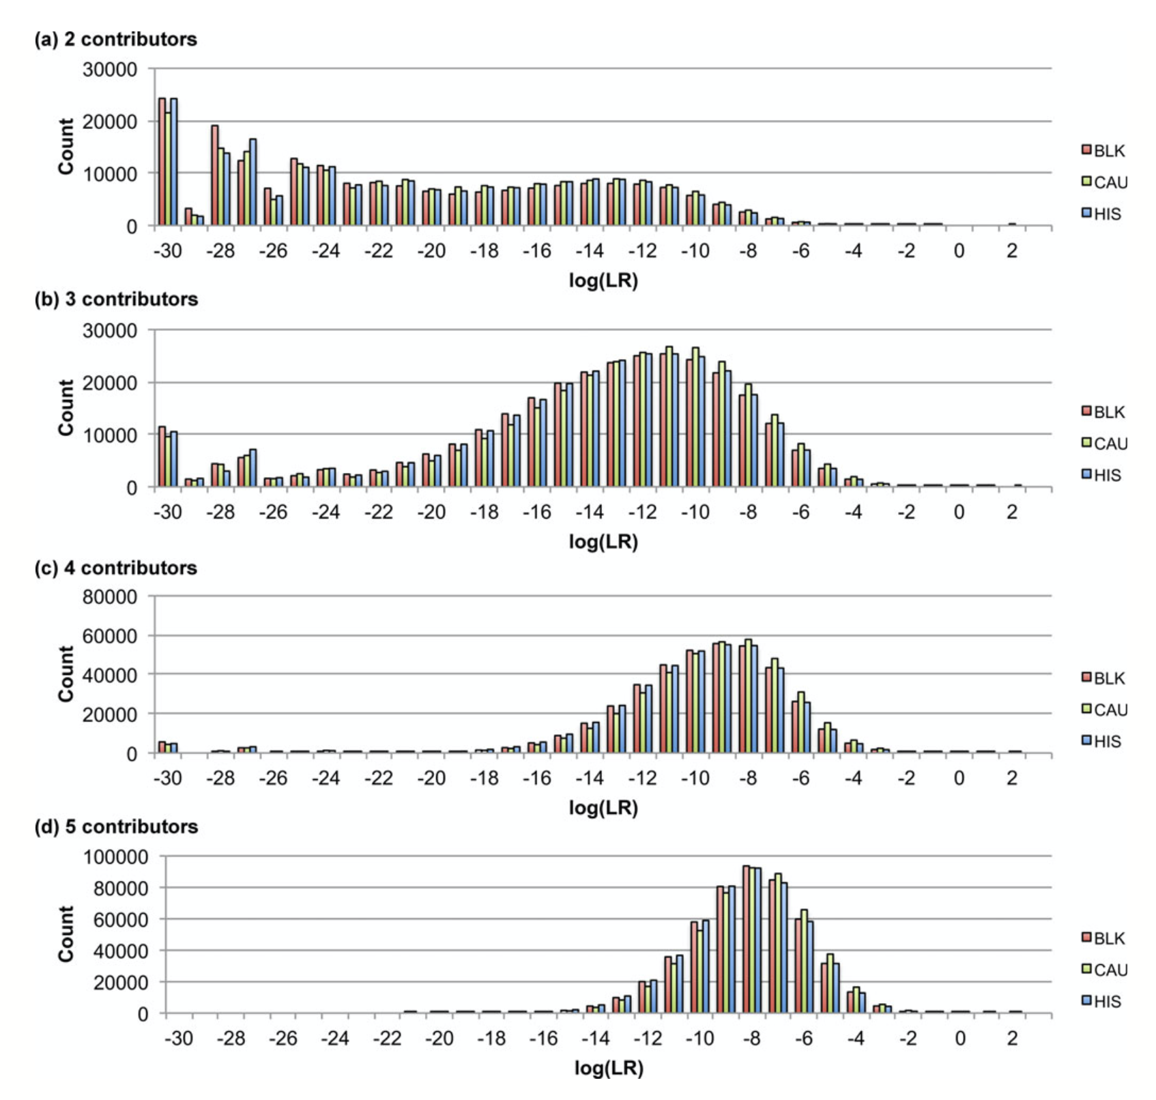
TrueAllele specificity
37
200 pg

Slide 38
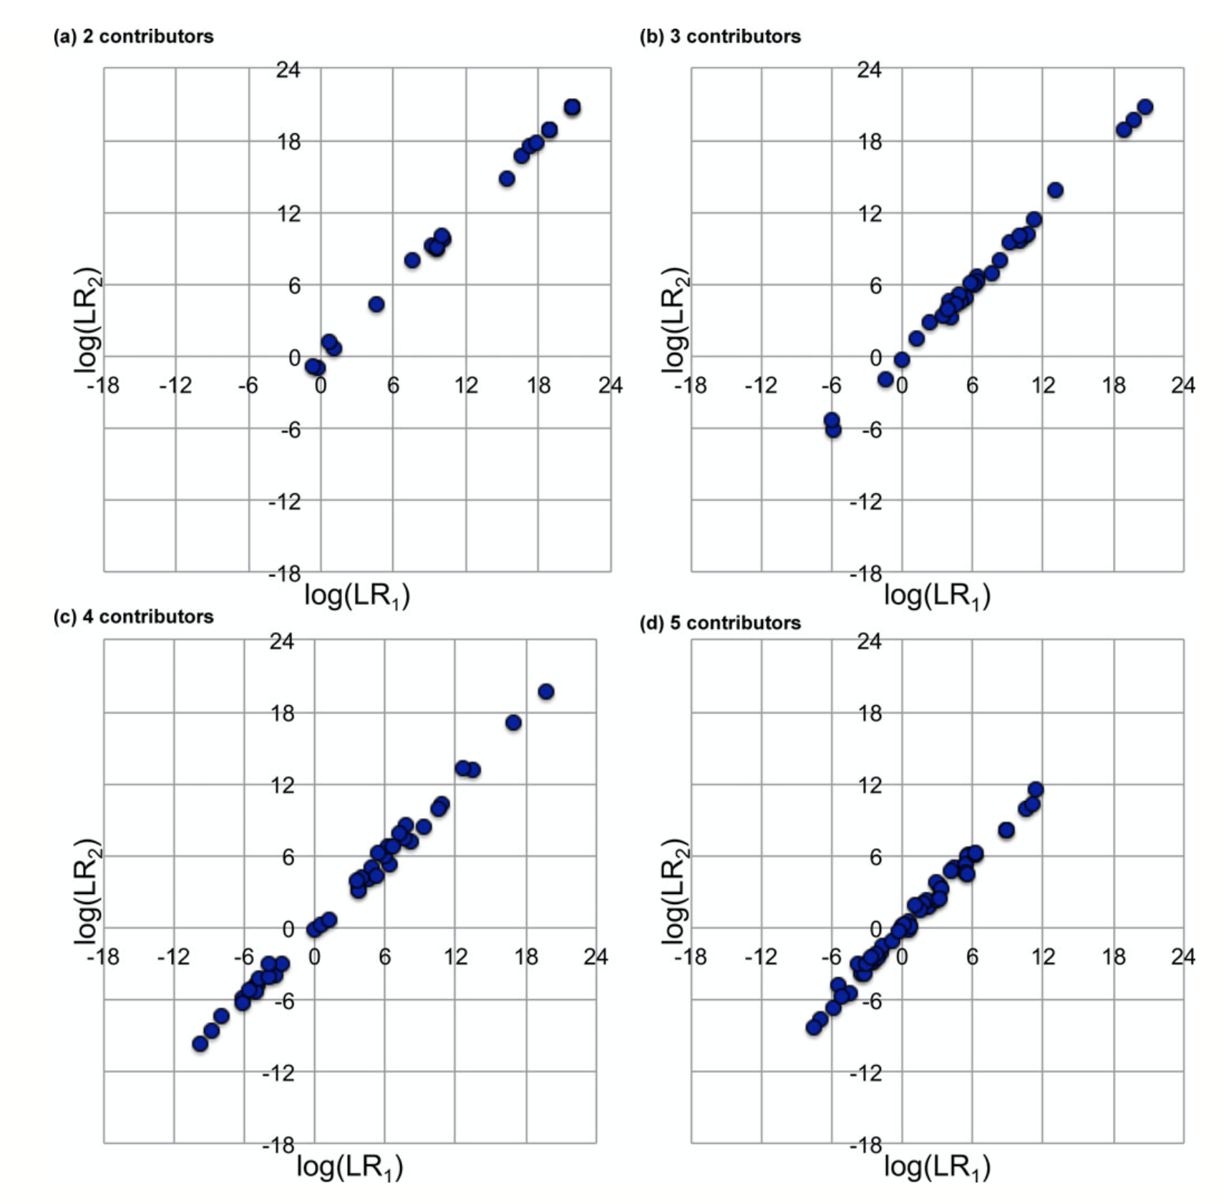
TrueAllele reproducibility
38
200 pg

Slide 39
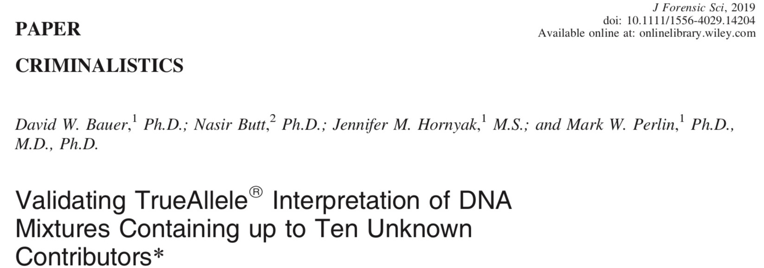
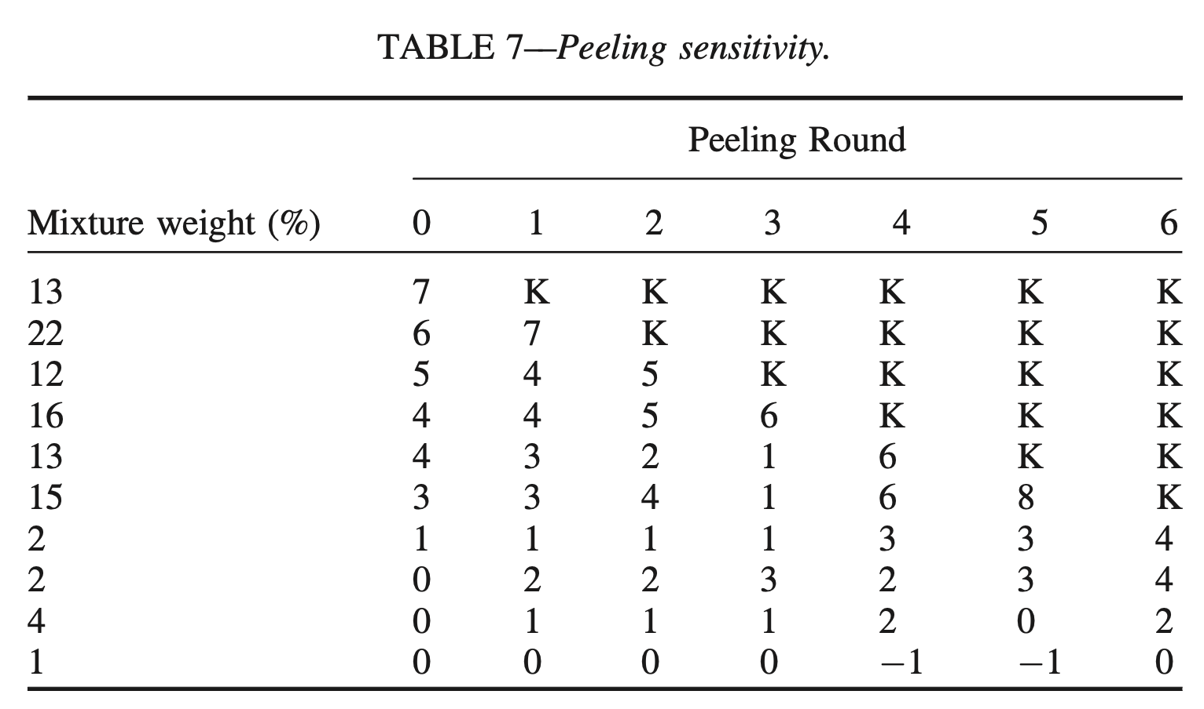
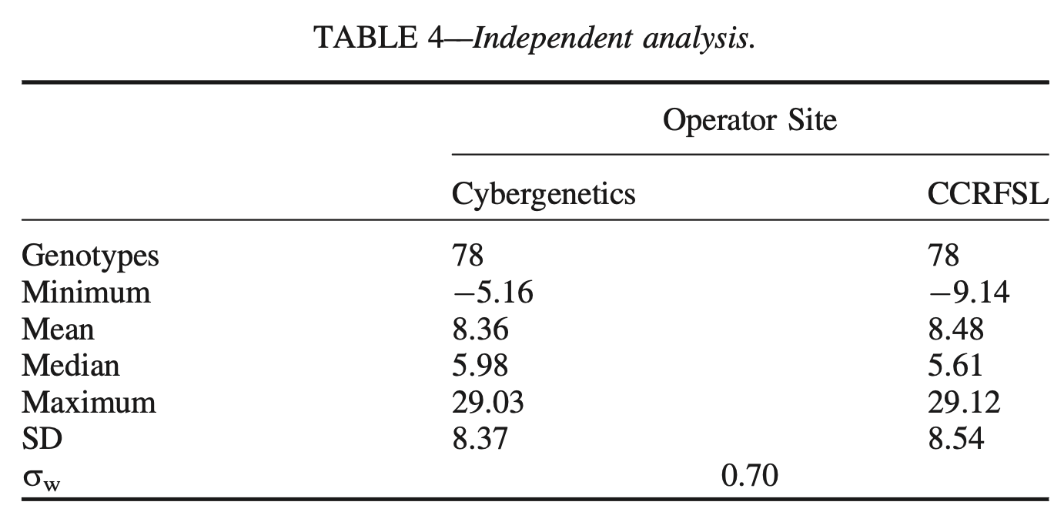

Slide 40
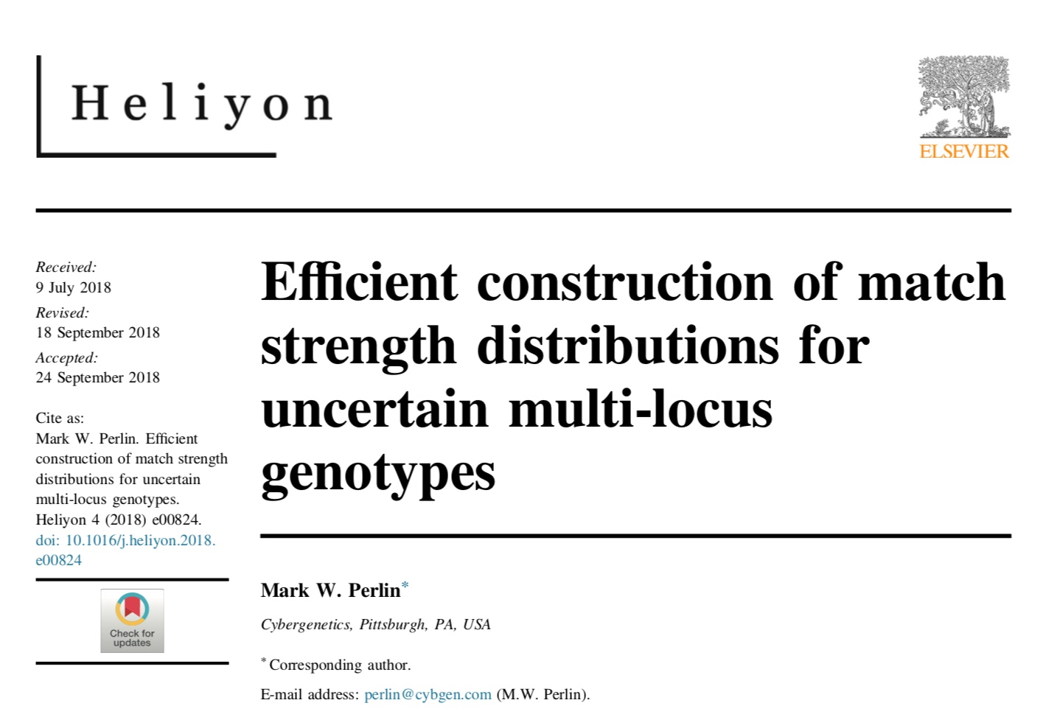
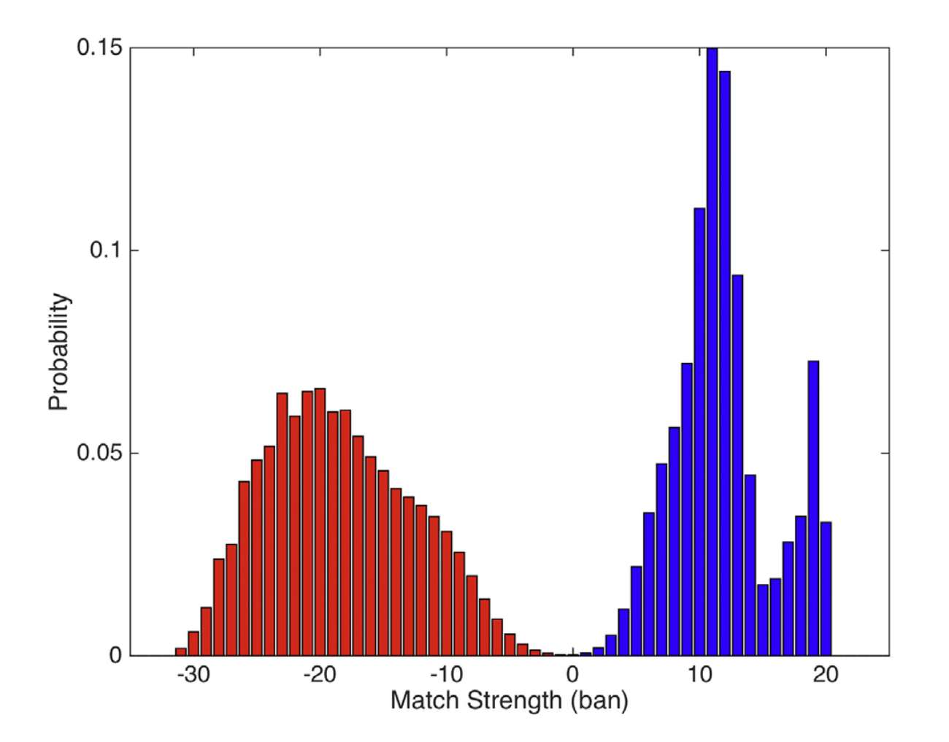
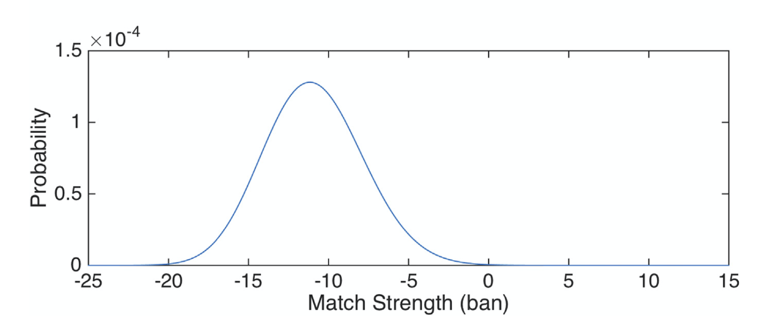

Slide 41
44 US admissibility rulings
Commonwealth of Pennsylvania v Kevin Foley (admitted, 2009; appellate precedent, 2012)
People of California v Dupree Langston (admitted, 2013)
Commonwealth of Virginia v Matthew Brady (admitted, 2013)
State of Ohio v Maurice Shaw (admitted, 2014)
State of Louisiana v Chattley Chesterfield & Samuel Nicolas (admitted, 2014)
People of New York v John Wakefield (admitted, 2015; appellate precedent, 2019; high court precedent, 2022)
State of South Carolina v Jaquard Aiken (admitted, 2015)
Commonwealth of Massachusetts v Heidi Bartlett (admitted, 2016)
State of Indiana v Dugniqio Forest (admitted, 2016)
State of Indiana v Malcolm Wade (admitted, 2016)
State of Washington v Emanuel Fair (admitted, 2017)
State of Louisiana v Harold Houston (admitted, 2017)
State of Indiana v Randal Coalter (admitted, 2017)
State of Nebraska v Charles Simmer (admitted, 2018; appellate precedent, 2019)
State of Indiana v Vaylen Glazebrook (admitted, 2018)
State of Ohio v David Mathis (admitted, 2018)
State of Florida v Lajayvian Daniels (admitted, 2018; appellate precedent, 2021)
State of Tennessee v Demontez Watkins (admitted, 2018; appellate precedent, 2021)
State of Georgia v Thaddus Nundra (admitted, 2019; appellate precedent, 2023)
State of Georgia v Monte Baugh & Thaddeus Howell (admitted, 2019)
State of Louisiana v Kyle Russ (admitted, 2019)
People of New York v Casey Wilson (admitted, 2019)
State of Georgia v Alexander Battle (admitted, 2019)
United States v Lenard Gibbs (admitted, 2019)
State of Georgia v Guy Sewell (admitted, 2019)
State of Georgia v Adedoja Bah (admitted, 2019)
State of Georgia v Nathaniel Day (admitted, 2019)
State of Tennessee v Abdullah Powell (admitted, 2021)
State of Georgia v Zarren Garner (admitted, 2021)
United States v Curtis Johnson, Jr. (admitted, 2021)
State of Georgia v Rahul Joseph Das (admitted, 2021)
State of Maryland v Tyrone Harvin (admitted, 2021)
State of Maryland v Gregory Jones (not used, Daubert not applied, 2021)
State of Georgia v Lashumbia Session (admitted, 2021)
State of Georgia v Bryan Byers (admitted, 2022)
State of Louisiana v Dermell Lewis, Corey Major, & Gerald Parker (admitted, 2022)
State of Louisiana v James Tabb (admitted, 2022)
State of Louisiana v Shawn Briscoe and Lance McIntyre (not used due to timeliness, 2022)
United States v Hunter Anderson (admitted, 2023)
State of Louisiana v Corlious Dyson (admitted, 2023)
United States v Ravel Mills (admitted, 2023)
United States v Damond Lockett (admitted, 2023)
State of Georgia v Erin Stephon Arms (admitted, 2023)
State of Ohio v Michael Carter (admitted, 2024)

Slide 42
TrueAllele today
42
Invented math & algorithms | 30 years
Developed computer systems | 25 years
Support users and workflow | 10 laboratories
Routinely used in casework | 450 agencies
Validate system reliability | 43 studies
Educate the community | 175 talks
Train or certify analysts | 400 students
Admissibility challenges | 42 rulings, 15 states and federal
Testify about LR results | 145 trials
Educate lawyers and public | 1,000 people
Make the ideas understandable | 1,250 cases, 46 states

Slide 43
Conclusions
Perlin MW, Dormer K, Hornyak J, Schiermeier-Wood L, Greenspoon S.
TrueAllele® Casework on Virginia DNA mixture evidence: computer and manual interpretation in 72 reported criminal cases. PLOS ONE. 2014;(9)3:e92837.
TrueAllele Casework DNA mixture interpretation is:
A reliable method
• objective
• sensitive
• specific
• reproducible
• accurate
TrueAllele computer genotyping is more effective than human review

