Slide 1
“Using Computer Technology to Overcome Bottlenecks in the Forensic DNA Testing Process and Improve Data Recovery from Complex Samples”
2018 AAFS Annual Scientific Meeting
February 22, 2018

Slide 2
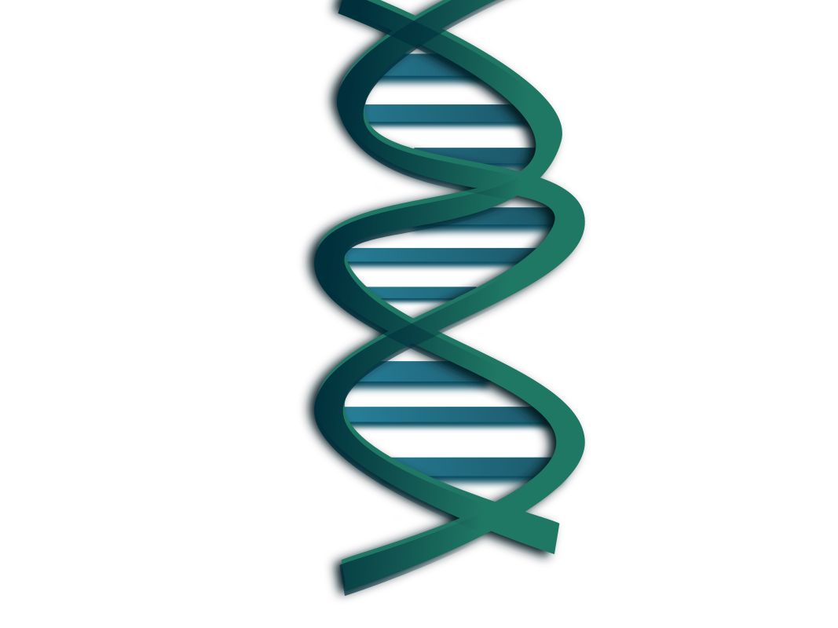
How Many DNA Profiles?
96-well plate
6 to 8 allelic ladders
At least two PCR controls
Several DNA extraction blanks
Typical plate could contain 80 to 84 DNA profiles

Slide 3
Interpretation Bottleneck
Eight hour workday
8 hours x 60 minutes = 480 minutes
480 minutes / 84 DNA profiles =
5 minutes, 42 seconds per DNA profile

Slide 4
Interpretation Bottleneck
Volume of data
Complexity
Thresholds

Slide 5
“Thresholds? Where we’re going, we don’t need thresholds.”

Slide 6
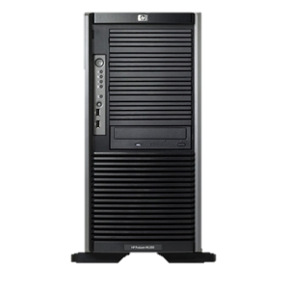
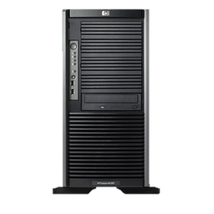
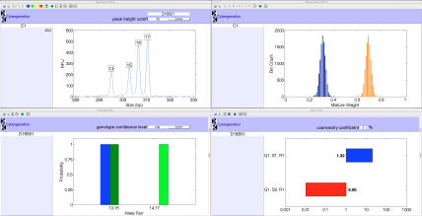
Automate DNA Interpretation with TrueAllele®
ViewStation
User Client
Database
Server
Interpret/Match
Expansion
Visual User Interface
VUIer™ Software
Parallel Processing Computers
Notes:
Describe TrueAllele system (left, middle, right, middle, left)

Slide 7
Automated Process
Upload entire plate to server
Computer interprets the mixtures
Automated matching
Operator checks results
Perform detailed processing on probative matches

Slide 8
Benefits of Automated DNA Interpretation
No thresholds, all data examined, nothing discarded
Speed
One plate in ~6 hours

Slide 9
Benefits of Automated DNA Interpretation
All data compared:
Evidence, references, lab staff, crime scene investigators, controls
Identify more case-to-case matches and potential contamination
CODIS specimen and candidate match assessment

Slide 10
CODIS Match Evaluation Example #1
Offender | Human Review, 30 minutes | TrueAllele,5 minutes | LR | CPI (1 in)
#1 | Uncertain | Eliminated | 1.5 | 39,000
#2 | Not eliminated | Eliminated | 2.7 | 39,000
#3 | Not eliminated | Match | 73 billion | 39,000

Slide 11
CODIS Match Evaluation Example #2
Offender | MME | CPI (1 in) | LR
#1 | 1.728 x 10⁴ | 65 | 158 trillion

Slide 12
Improved Data Recovery
Uploaded 7 years of data to TrueAllele®
>7,500 DNA profiles (Q and K)
~ 15,000 inferred genotypes
Compared all data

Slide 13
Previously Unidentified Matches
2014: Burglary case, uploaded to SDIS
Offender hit
Match confirmed in laboratory
2017: Process old data, upload to TrueAllele®
3 additional cases from 2012 - 2014
Never entered into CODIS

Slide 14
Can we use the automated process for CODIS screening?
Minimum
#
4x4
CPI
Sample
Major
?
LR
Contributors
Rule?
(1
in
)
2012
3
No
No
28,000
6 quintillion
2013
3
No
No
920
27 trillion
2014
3
No
No
760
9 trillion

Slide 15
CODIS Screening
KL computed by TrueAllele®
Measures information value of inferred genotype
MME calculated by CODIS
Predicts matches at moderate stringency
Compare MME, KL, and LR for CODIS profile assessment

Slide 17
What We Are Implementing
Use KL to predict quality of match
Use MME to filter adventitious matches
High KL – build MME, search CODIS
Low KL – do not upload

Slide 18
Summary
DNA interpretation is automatable
Reduce/eliminate interpretation bottlenecks
Output searched internally and screened for suitable CODIS profiles
More information recovered from same amount of data

Slide 19
Thank you!

