Slide 1

Getting more from less: low-level DNA mixtures on cartridges
Kari R. Danser, MS, Jennifer M. Bracamontes, MS, Megan M. Foley, MS, Matthew M. Legler, BS,
Mark W. Perlin, PhD, MD, PhD

Slide 2
Disclaimer
The views and opinions expressed in this presentation are those of the presenter/author, and does not represent any official views or opinions of the American Academy of Forensic Sciences.
I am an employee of Cybergenetics.
TrueAllele® Casework DNA interpretation technology that was developed by Cybergenetics was used during this study.

Slide 3
Background
Cartridge casings are the empty shells left behind after a gun was fired¹
Nearly 200,000 cartridge cases are recovered annually at U.S. crime scenes¹
Cartridges that were fired degrade any DNA that was left and have significantly less DNA²
Caliber of the firearm did not have any impact on the amount of DNA recovered²
1.“Shelling out Evidence: NIST Ballistic Standard Helps Tie Guns to Criminals.” NIST, 23 Jan. 2023, www.nist.gov/news-events/news/2012/08/shelling-out-evidence-nist-ballistic-standard-helps-tie-guns-criminals.
2. Prasad, Elisha, et al. “Touch DNA recovery from unfired and fired cartridges: Comparison of swabbing, tape lifting and soaking.” Forensic Science International, vol. 330, Jan. 2022, p. 111101, https://doi.org/10.1016/j.forsciint.2021.111101.

Slide 4
Study Design
Sample Creation
DNA Collection
DNA Extraction
Manual Interpretation
TrueAllele Interpretation
Information Comparison

Slide 5
Sample Creation and DNA Collection
Single source data
  910 total cartridge casings
  Across 7 different cartridge types
DNA was collected using five collection types
  Wet:Wet
  Wet:Dry
  Soak and Sonicate
  Tape Lift
  Scraping
 | Collection
Material | Wet:Wet | Wet:Dry | Soak and Sonicate | Tape Lift | Scraping
45 Fired | 30 | 30 | 30 | N/A | N/A
45 Unfired | 30 | 30 | 30 | N/A | N/A
Aluminum Unfired | 30 | 30 | 30 | 30 | 30
Brass Fired | 30 | 30 | 10 | 30 | 30
Brass Unfired | 30 | 30 | 30 | 30 | 30
Nickel Unfired | 30 | 30 | 30 | 30 | 30
Steel Unfired | 30 | 30 | 30 | 30 | 30

Slide 6
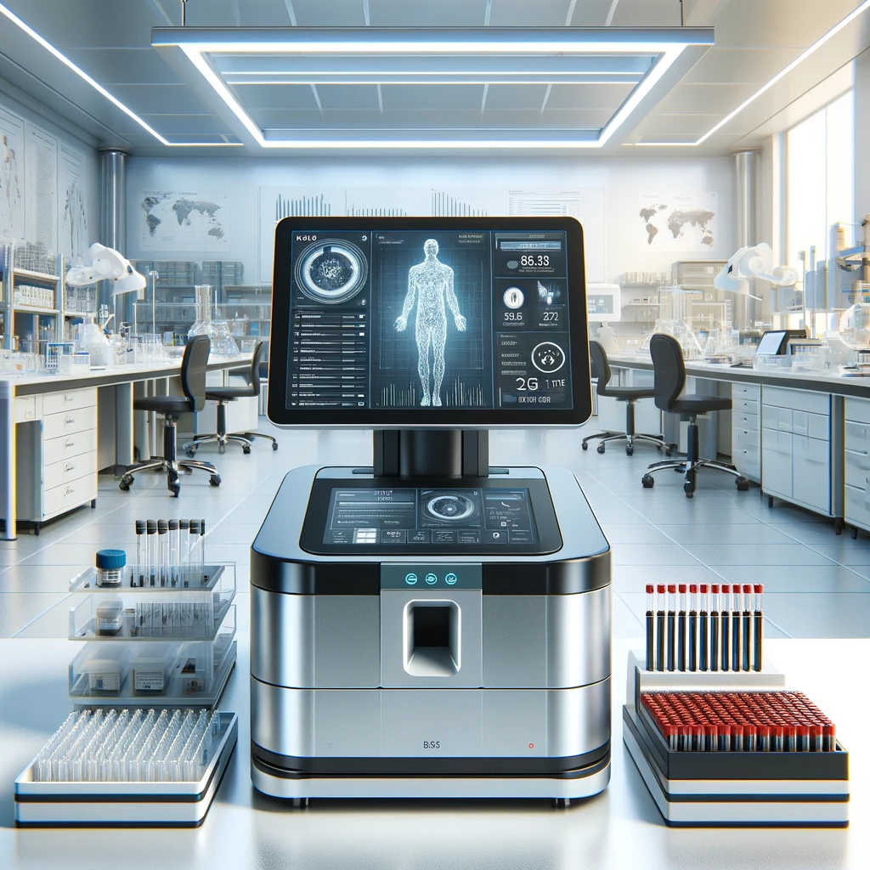
DNA Extraction
Organic extraction
  Organic solvents are used for denaturation
  Denatured proteins are removed then washed
DNA sequencer
  Applied Biosystems® 3500 Genetic Analyzer
STR kit
  Applied Biosystems GlobalFiler™

Slide 7

Manual Allele Interpretation
A university laboratory manually interpreted the data
A peak height threshold was applied to EPG data to form allele events
Allele counts: how many EPG allele events match a reference

Slide 8


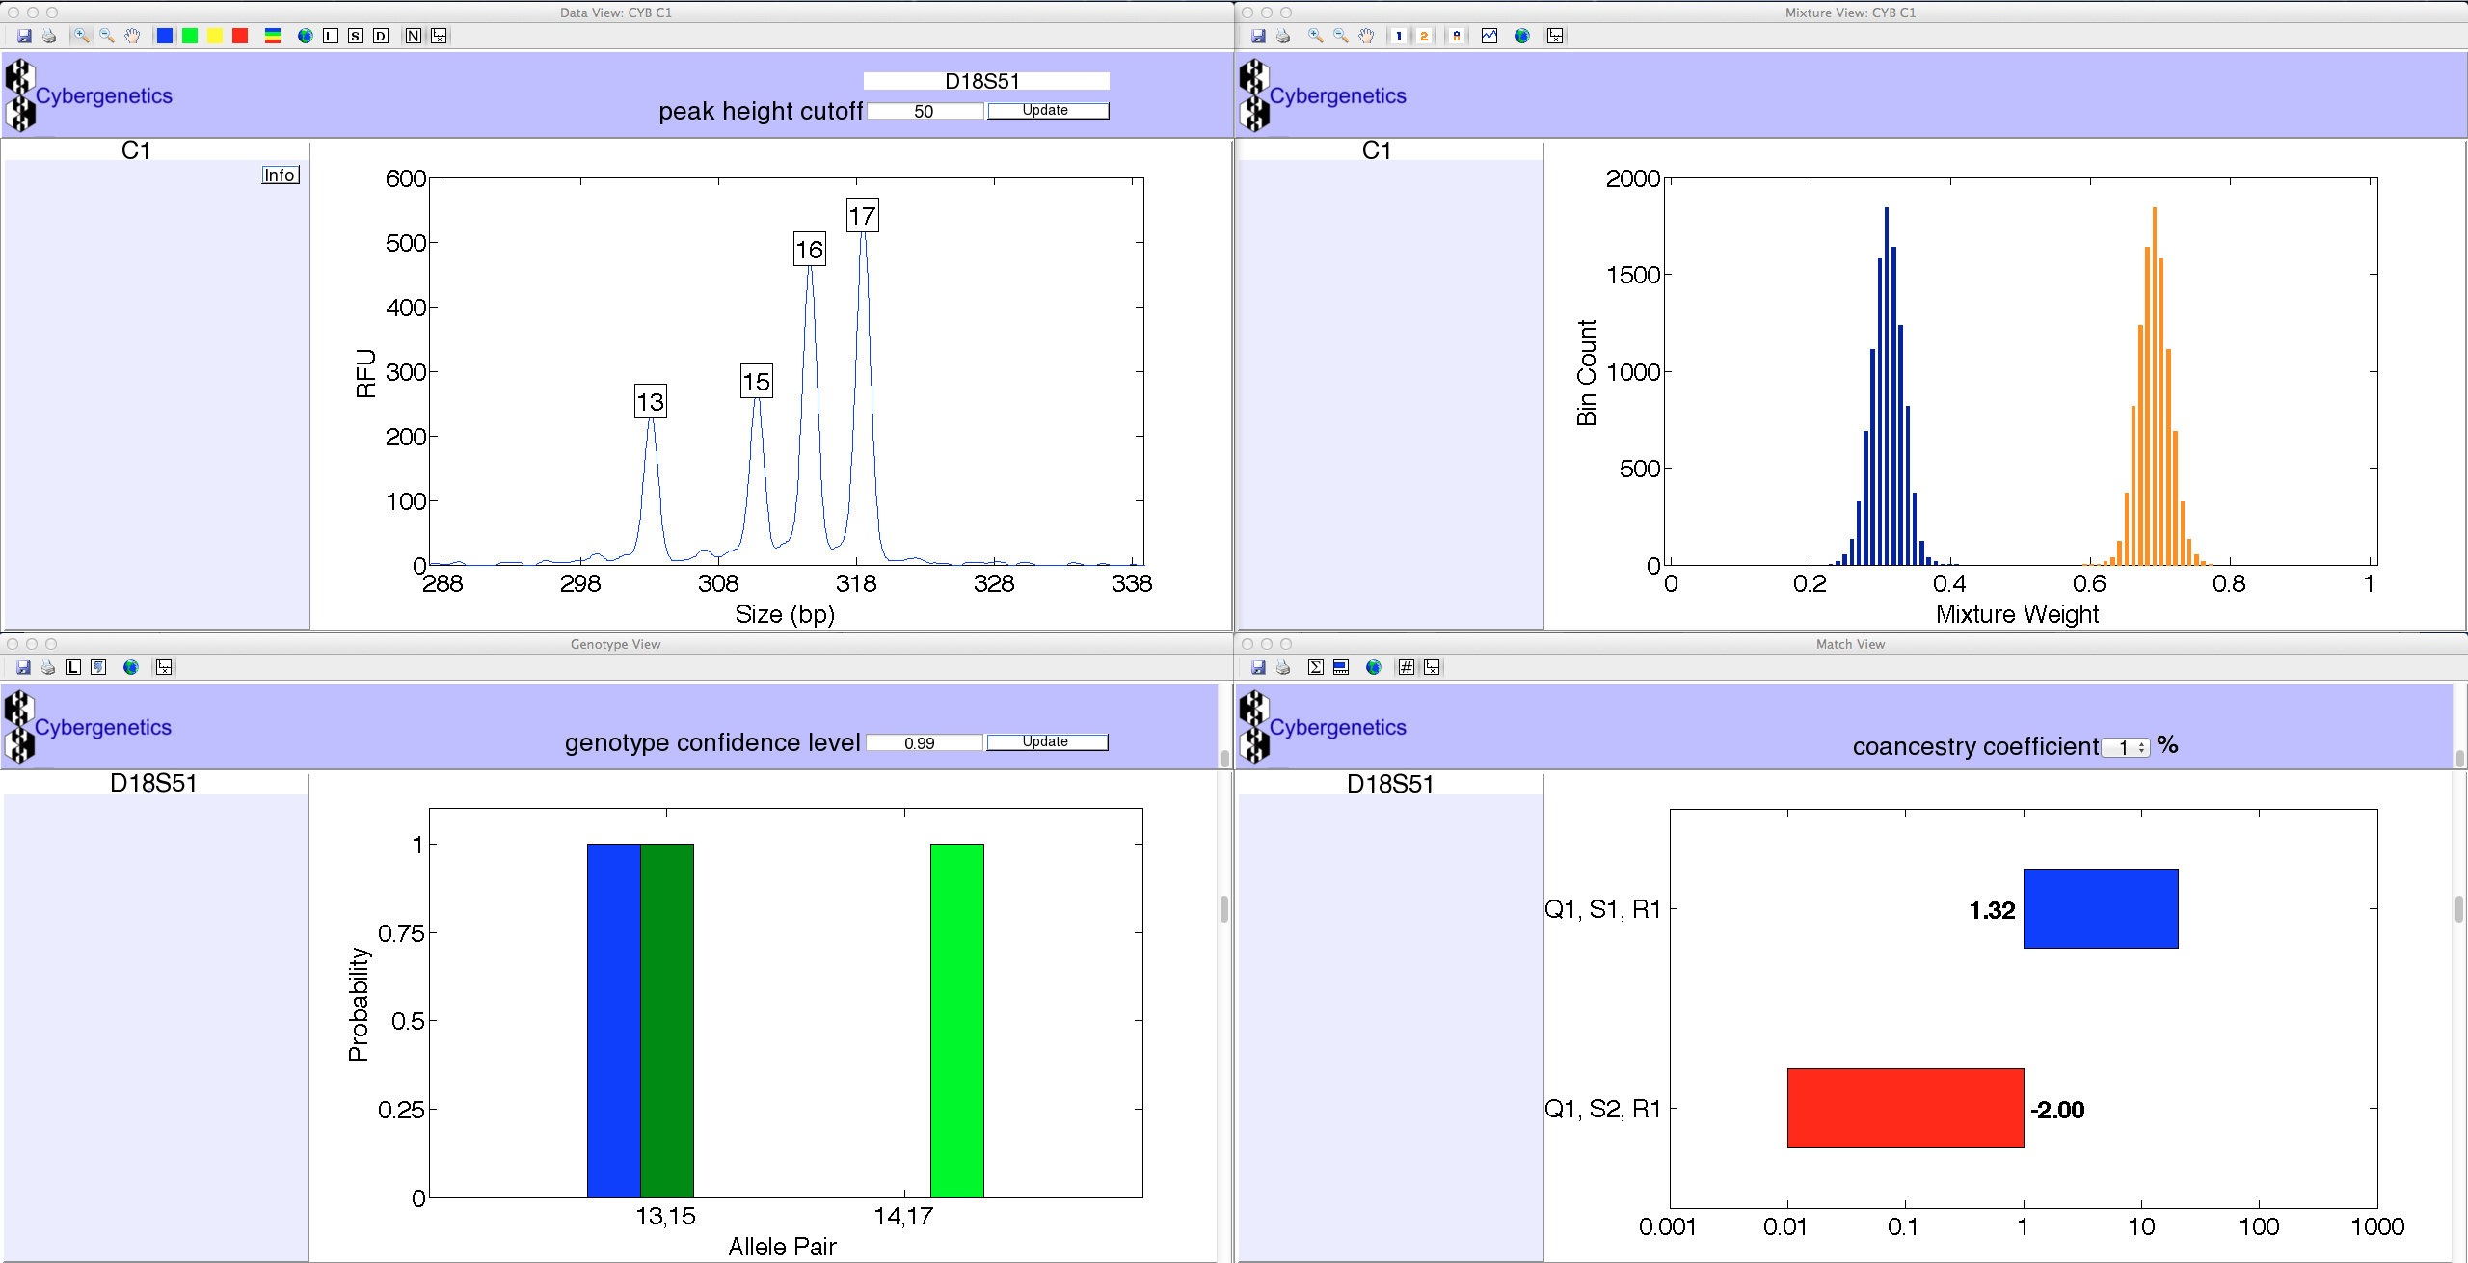

TrueAllele Casework Interpretation
Cybergenetics generated TrueAllele requests assuming the samples were single source
Completely objective and unbiased
  TrueAllele processes DNA data without knowing a reference
Kullback-Leibler (KL) genotype statistic
  Quantifies the identification information in a genotype
  The expected log(LR) to the true contributor
Likelihood Ratio (LR) match statistic
  Compares genotype to known reference

Slide 9
Mixtures and Low-Level Data
Most cartridges had a high TrueAllele KL: the DNA was informative
Low-level data, little DNA: uninformative manual interpretation
  Percentage of low-level samples for each cartridge type (Table 1)
431 (of 910) samples were found to be mixtures
  Total number of mixtures for each cartridge type (Table 2)
Percentage of Low-Level Samples
Collection
Material | Wet:Wet | Wet:Dry
45 Fired | 40 | 73
45 Unfired | 40 | 36
Aluminum Unfired | 0 | 16
Brass Fired | 3 | 16
Brass Unfired | 6 | 30
Nickel Unfired | 6 | 13
 | Collection
Material | Wet:Wet | Wet:Dry | Soak and Sonicate | Tape Lift | Scraping
45 Fired | 10 | 7 | 8
45 Unfired | 13 | 15 | 9
Aluminum Unfired | 24 | 17 | 9 | 27 | 11
Brass Fired | 16 | 12 | 1 | 16 | 10
Brass Unfired | 14 | 15 | 0 | 29 | 15
Nickel Unfired | 16 | 20 | 1 | 26 | 6
Steel Unfired | 19 | 21 | 9 | 22 | 13

Slide 10
TrueAllele Interpretation Round 2
Cybergenetics generated requests for the mixture data
TrueAllele Casework processed the requests
  Some items had multiple contributor assumptions
  Samples contained 2 to 5 contributors
TrueAllele found an unknown person in many of the cartridges
  We compared the cartridge samples with the unknown profile

Slide 11
TrueAllele Information Comparison
All cartridge samples compared to reference
LR match statistic calculated for each comparison
  351 inclusionary statistics for the reference
  Total number of inclusionary statistics per cartridge type is shown in the table
 | Collection
Material | Wet:Wet | Wet:Dry | Soak and Sonicate | Tape Lift | Scraping
45 Fired | 1 | 0 | 9 | N/A | N/A
45 Unfired | 12 | 19 | 6 | N/A | N/A
Aluminum Unfired | 26 | 18 | 9 | 29 | 11
Brass Fired | 5 | 13 | 1 | 3 | 3
Brass Unfired | 8 | 7 | 1 | 22 | 0
Nickel Unfired | 15 | 24 | 0 | 18 | 3
Steel Unfired | 18 | 22 | 17 | 17 | 14

Slide 12

TrueAllele Finds Unknown Contributor
The unknown profile was in many samples
  Found in 138 of the 910 cartridge samples
  Total number of inclusionary statistics for the unknown contributor
The unknown profile was informative
  Its KL was 30.36 ban
Who’s DNA is in the unknown profile?
  We don’t know
 | Collection
Material | Wet:Wet | Wet:Dry | Soak and Sonicate | Tape Lift | Scraping
45 Fired | 1 | 2 | 2 | N/A | N/A
45 Unfired | 10 | 2 | 8 | N/A | N/A
Aluminum Unfired | 4 | 4 | 0 | 9 | 0
Brass Fired | 14 | 3 | 1 | 5 | 3
Brass Unfired | 9 | 1 | 0 | 10 | 1
Nickel Unfired | 9 | 3 | 1 | 10 | 0
Steel Unfired | 6 | 1 | 3 | 13 | 3

Slide 13
Nickel Unfired Example
Table: statistics for one combination (Unfired Nickel + Wet:Wet)
  KL and log(LR) inclusionary averages for the reference and unknown person
  The number of zeros after the 1 in the match statistic (ban)
  Blank entry: no data available
  The inclusionary LR values ranged from 10’s of billions to 10’s of quadrillions (really, really informative)
A log(LR) of 10.0 ban is 10,000,000,000
  Large inclusionary DNA match statistic
  TrueAllele average from 3-person mixtures
 | ref inclusion |  | unknown inclusion
# of contrib | KL | log(LR) | KL | log(LR)
1 | 26.86 | 15.08
2 | 15.53 | 10.27 | 22.71 | 16.14
3 | 13.94 | 10.06 | 14.64 | 11.38
But human review got no information at all!

Slide 14
Study Conclusions
Manual interpretation used allele counting and thresholds
  Could only find the known reference
TrueAllele considered additional mixture contributors
  The computer calculated match statistics for both the reference and unknown profile
  The computer’s developed unknown enabled comparison between the different cartridge mixtures
  The known reference was found in 351 samples (205 manually)
  The unknown person was found in 138 samples (0 manually)

Slide 15
Study Conclusions
More informative collection method
  Wet:Wet or Wet:Dry
  Tape Lift was close
Least informative was Scraping / Soak and Sonicate
Most informative cartridge type was Aluminum / Steel
The least informative was 45 Fired

Slide 16
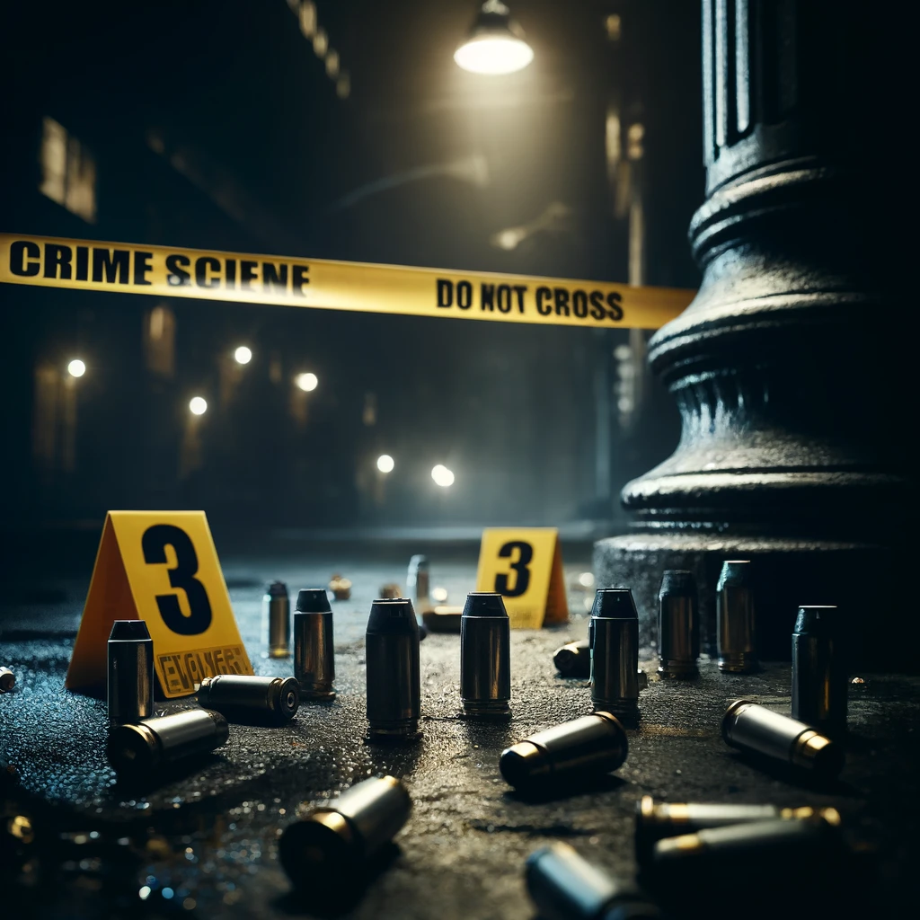
Study Conclusions
TrueAllele can develop informative data from cartridges
  All DNA data is used, none discarded
  Handles low-level data and minor contributors
  Cartridges are common crime scene evidence
  TrueAllele motivates gathering cartridge evidence
Methods that use less data are less informative
Cybergenetics has analyzed almost a hundred cartridge cases using TrueAllele, getting more DNA information from crime lab data

Slide 17


Questions?
kari@cybgen.com
www.cybgen.com

