Slide 1

The path to precedent for Maryland probabilistic genotyping
Mid-Atlantic Association of Forensic Scientists
Richmond, Virginia
May, 2025
Jennifer M. Bracamontes, MS
William P. Allan, MS
Mark W Perlin, PhD, MD, PhD
Cybergenetics © 2003-2025

Slide 2
TrueAllele® computer solution
2
• Accurate. 43 validation studies, 8 published
• Objective. Workflow removes human bias
• Accepted. Reported in 47 states, used by 10 labs
• Transparent. Give math, software (4GB DVD)
• Neutral. Can statistically include or exclude

Slide 3
TrueAllele in Maryland
3
Cybergenetics Maryland cases 34
Trial testimony 5
  Maryland v. Nelson Clifford
  Maryland v. Omar McGee
  Maryland v. Calvin Odera
  Maryland v. Andy Panton
  Maryland v. Michael Brown Jr.
Post-conviction hearings 2
  Maryland v. William Jamison
  Maryland v. Rodney Brown
Baltimore Police Department
Forensic Science and Evidence Services Division
  TrueAllele laboratory
  (using for over ten years)

Slide 4
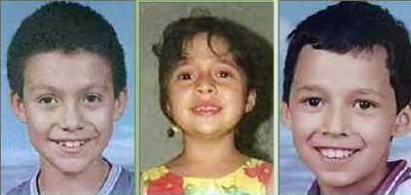
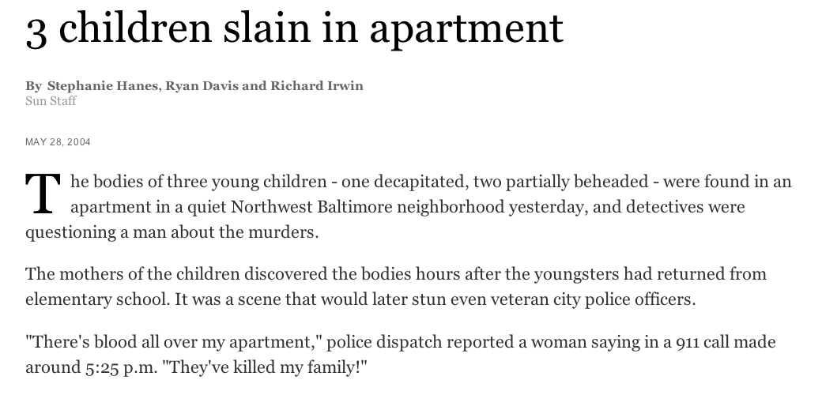
Maryland v. Adan Canela
4

Slide 5

Maryland v. Nelson Clifford
5
11%
82%
7%
contributor
1
contributor
2
contributor
3
match
statistic

Slide 6
Maryland v. Tyrone Harvin
6
83-year-old woman found beaten and sexually assaulted, dies in hospital
14-year-old Tyrone Harvin charged with victim’s rape and murder
Evidence: 2 condoms and swabs of broken lamp
Baltimore City TrueAllele® DNA mixture analysis:
At least 2 contributors to the mixtures
Matches to victim and defendant (LR in millions)

Slide 7
Defense Challenge
7
Motion in Limine to Exclude Results of TrueAllele Probabilistic Genotyping as Violative of Provisions of the United States Constitution and the Maryland Declaration of Rights and Request for Hearing
Defendant requests this court to exclude, the results of DNA testing predicated in part, upon the use of TrueAllele probabilistic genotyping
As grounds for his motion, Defendant asserts probabilistic genotyping violates the Maryland Declaration of Rights and the United States Constitution because it shifts the burden of proof because likelihood ratios prompt juries to convict “without proof beyond a reasonable doubt," thereby altering the State’s burden of proof.

Slide 8
Maryland reliability standard
8
United States: Daubert v. Merrell-Dow
Has been or can be tested
Peer review and publication
Known or potential rate of error
Existence of standards and controls
Generally accepted (Frye)
Maryland: Rochkind v. Stevenson
Expert’s testimony flows naturally and directly from research he conducted independent of the litigation or whether the opinions are developed expressly for purposes of testifying
Expert unjustly extrapolated from an accepted premise to an unfounded conclusion
Expert adequately accounted for obvious alternative explanations
Expert is being as careful as he would be in his regular profession outside his paid litigation consulting
Field of expertise the expert claims is known to reach reliable results for the type of opinion the experts would give

Slide 9
TrueAllele reliability materials
9
Background Readings
Validation Papers
Validation Studies
Forensic Applications
DNA Exonerations
Regulatory Approval
Standards Compliance
Method Reports
General Acceptance
Related Systems
Admissibility Rulings
Legal Commentary
Scientific Development
Other Papers

Slide 10
Peer-reviewed validation studies
10
Perlin MW, Sinelnikov A. An information gap in DNA evidence interpretation. PLoS ONE. 2009;4(12):e8327.
Ballantyne J, Hanson EK, Perlin MW. DNA mixture genotyping by probabilistic computer interpretation of binomially-sampled laser captured cell populations: Combining quantitative data for greater identification information. Science & Justice. 2013;53(2):103-114.
Perlin MW, Hornyak J, Sugimoto G, Miller K. TrueAllele® genotype identification on DNA mixtures containing up to five unknown contributors. Journal of Forensic Sciences. 2015;60(4):857-868.
Greenspoon SA, Schiermeier-Wood L, Jenkins BC. Establishing the limits of TrueAllele® Casework: a validation study. Journal of Forensic Sciences. 2015;60(5):1263-1276.
Bauer DW, Butt N, Hornyak JM, Perlin MW. Validating TrueAllele® interpretation of DNA mixtures containing up to ten unknown contributors. Journal of Forensic Sciences. 2020; 65(2):380-398.
Perlin MW, Legler MM, Spencer CE, Smith JL, Allan WP, Belrose JL, Duceman BW. Validating TrueAllele® DNA mixture interpretation. Journal of Forensic Sciences. 2011;56(6):1430-1447.
Perlin MW, Belrose JL, Duceman BW. New York State TrueAllele® Casework validation study. Journal of Forensic Sciences. 2013;58(6):1458-1466.
Perlin MW, Dormer K, Hornyak J, Schiermeier-Wood L, Greenspoon S. TrueAllele® Casework on Virginia DNA mixture evidence: computer and manual interpretation in 72 reported criminal cases. PLOS ONE. 2014;(9)3:e92837.

Slide 11
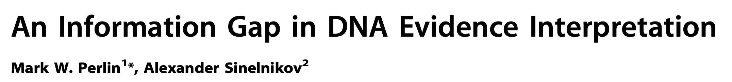

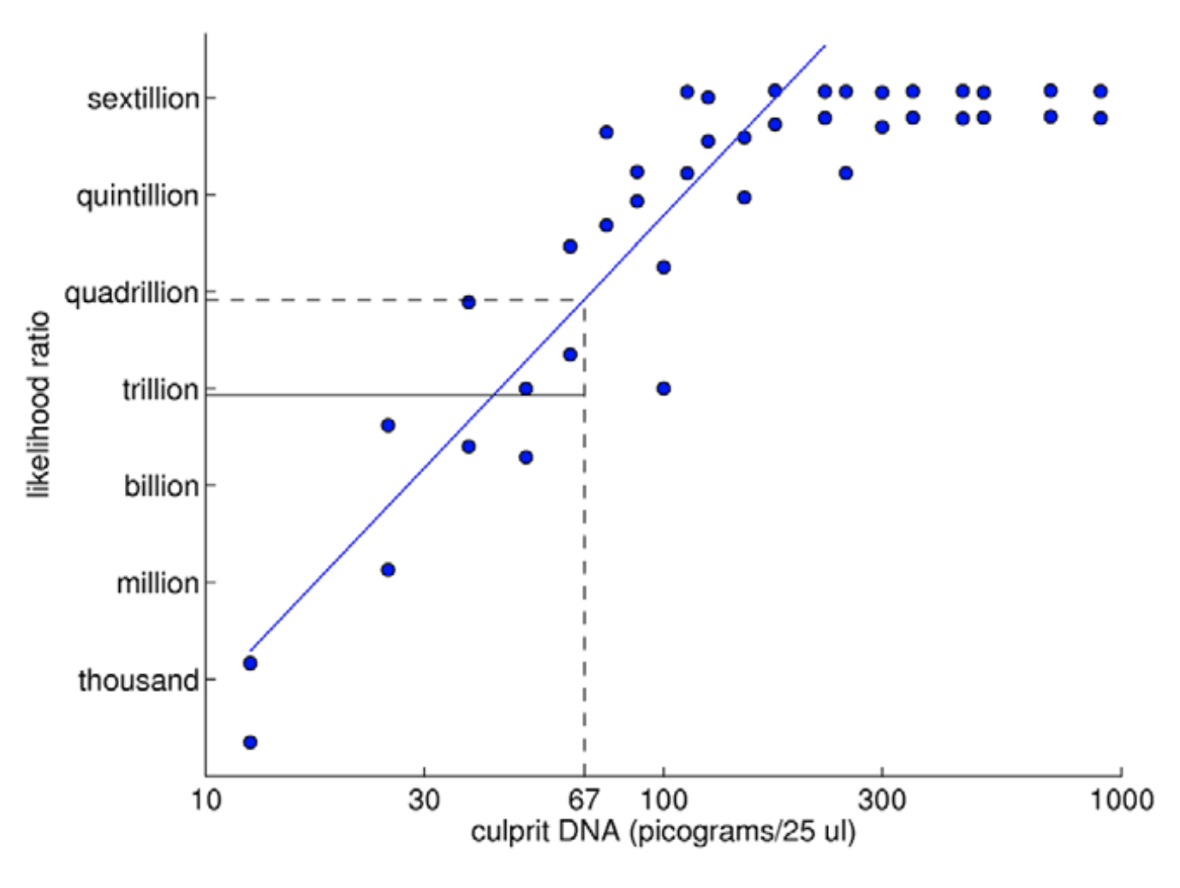
TrueAllele predictability
11
2009

Slide 12
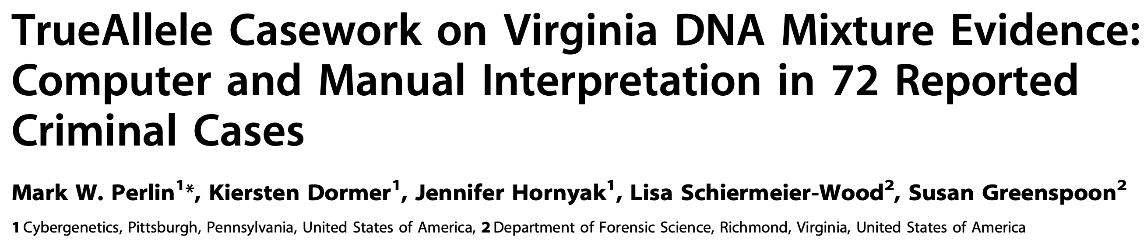
TrueAllele reliability
12
2014
Validation axes
• sensitive
• specific
• reproducible

Slide 13
TrueAllele sensitivity
13
log(LR) match distribution
11.05 (5.42)
113 billion
TrueAllele

Slide 14
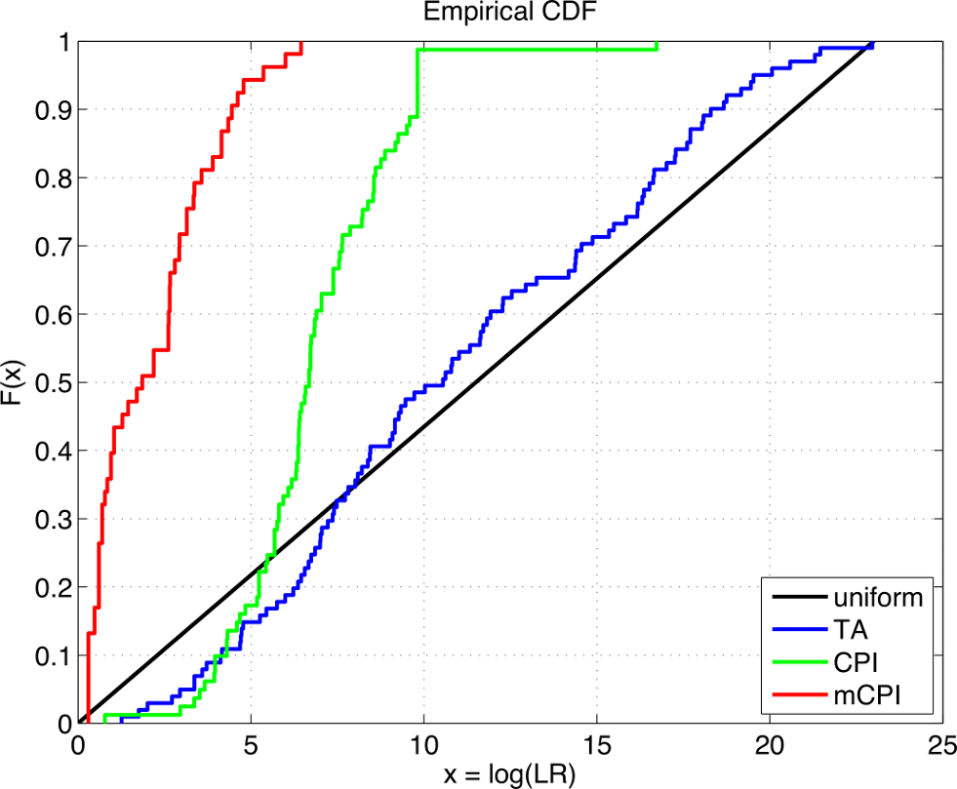
TrueAllele accuracy
14

Slide 15
TrueAllele specificity
15
log(LR) nonmatch distribution
– 19.47

Slide 16
Higher human error rate
16
TrueAllele specificity (million samples)
From noncontributor distribution, for LR > 100:
Error rate = 1 in 1,000,000 (0.0001)%
CPI – analytical threshold
5 false positives in 81 comparisons
Error rate = 5 in 81 (6%)
mCPI – stochastic threshold
17 inconclusive results
1 false positive in 53 comparisons
Error rate = 1 in 53 (2%)

Slide 17
TrueAllele reproducibility
17
Concordance in two independent computer runs
standard deviation
(within-group)
0.305

Slide 18
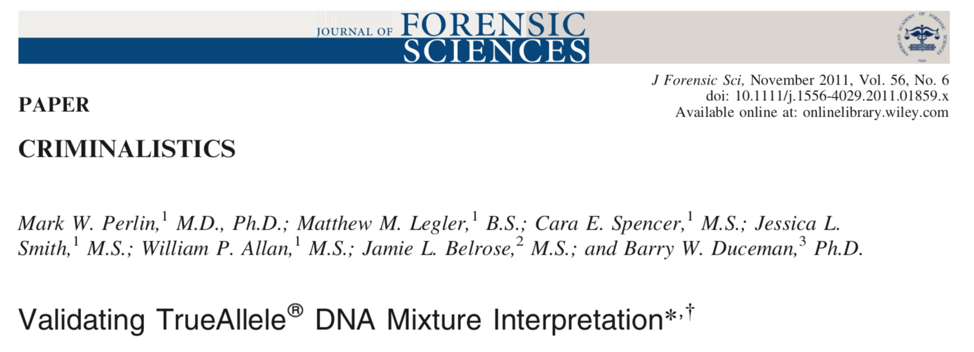
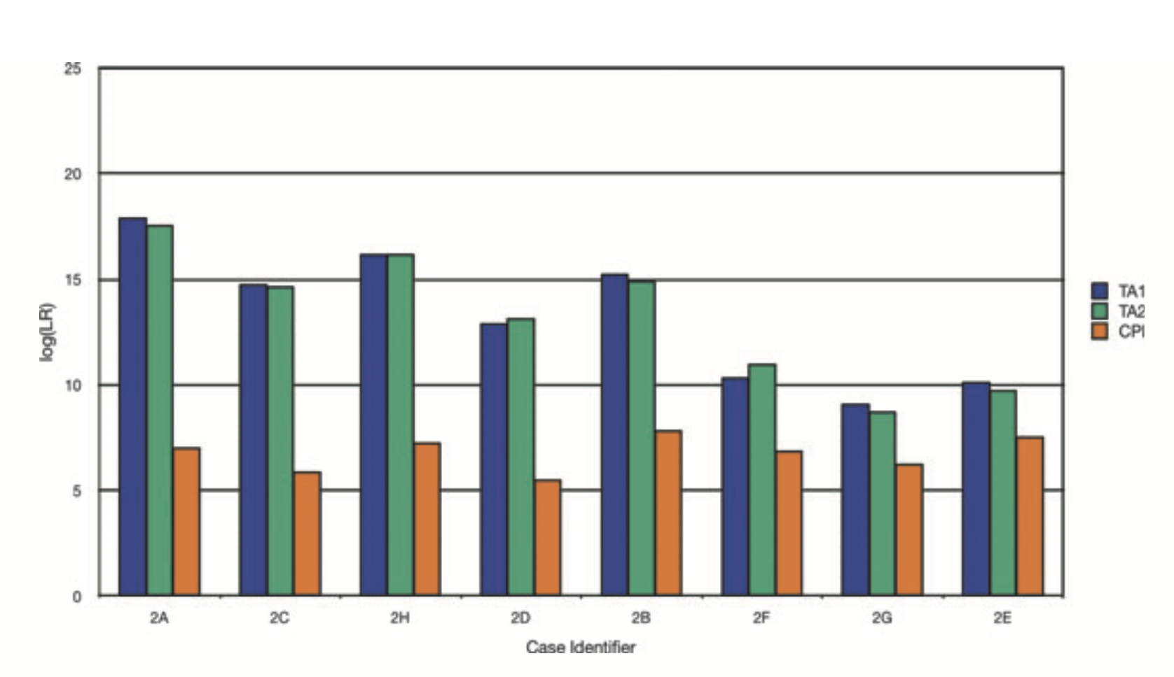
18

Slide 19
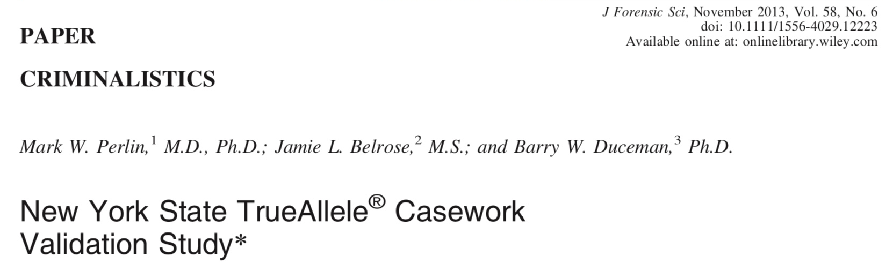
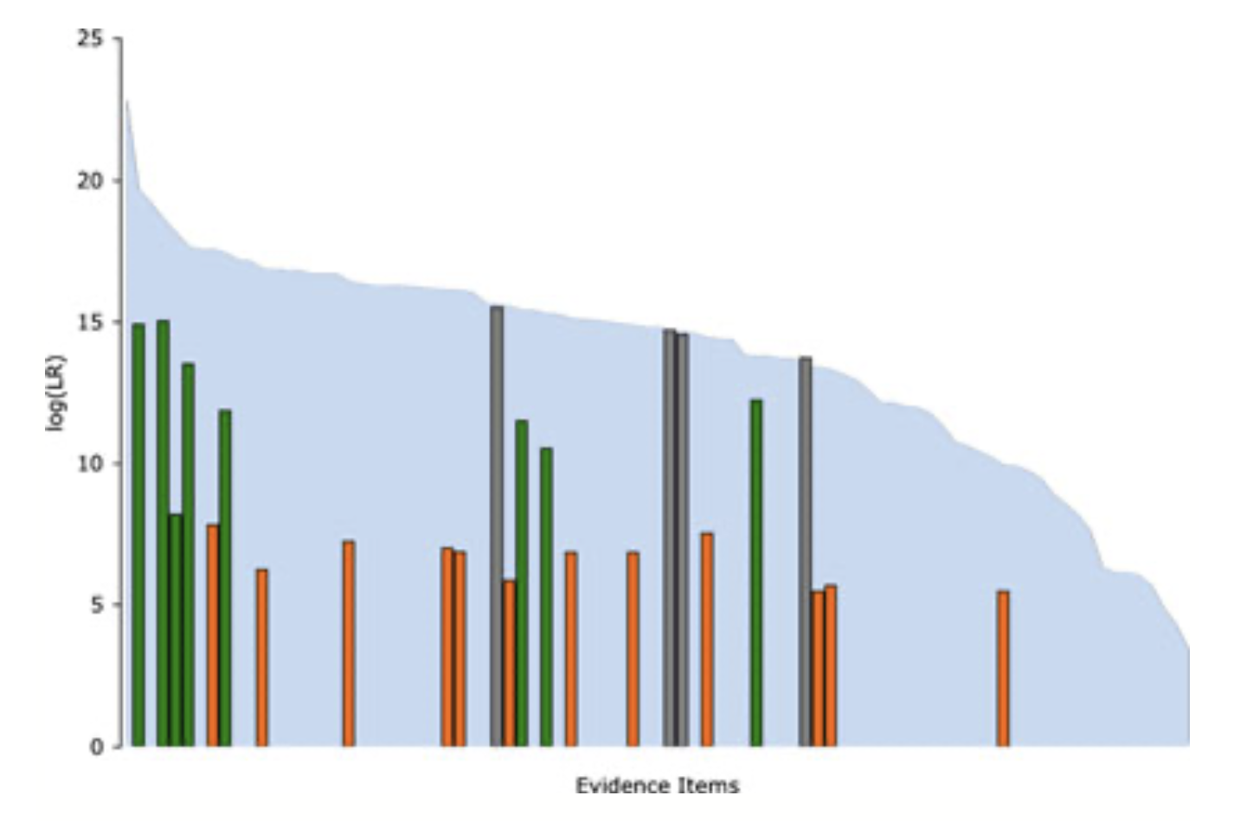
19

Slide 20
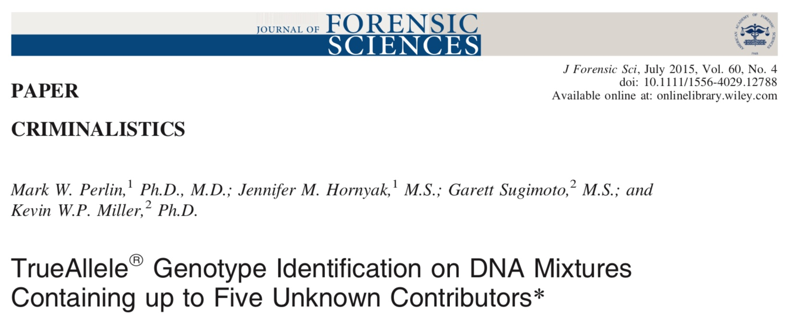
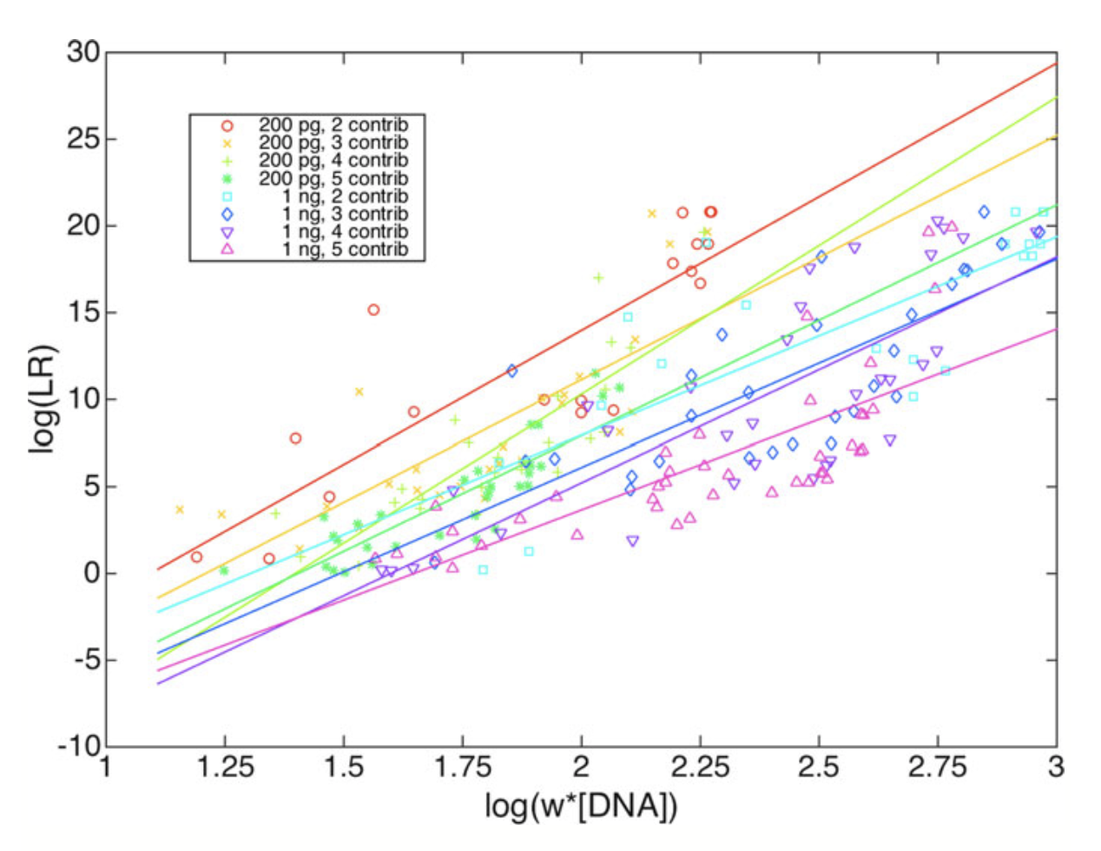
20

Slide 21
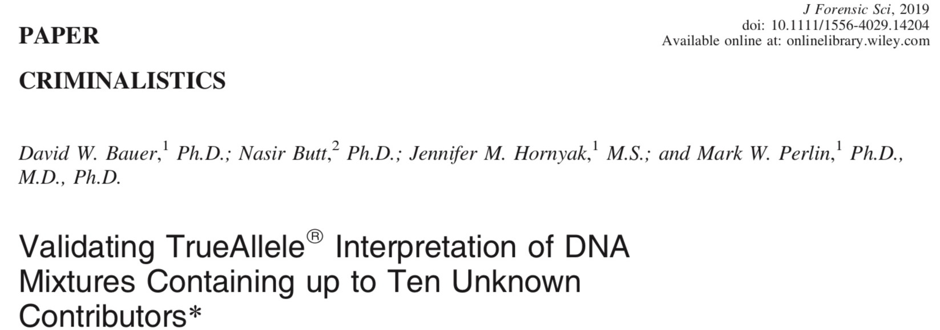
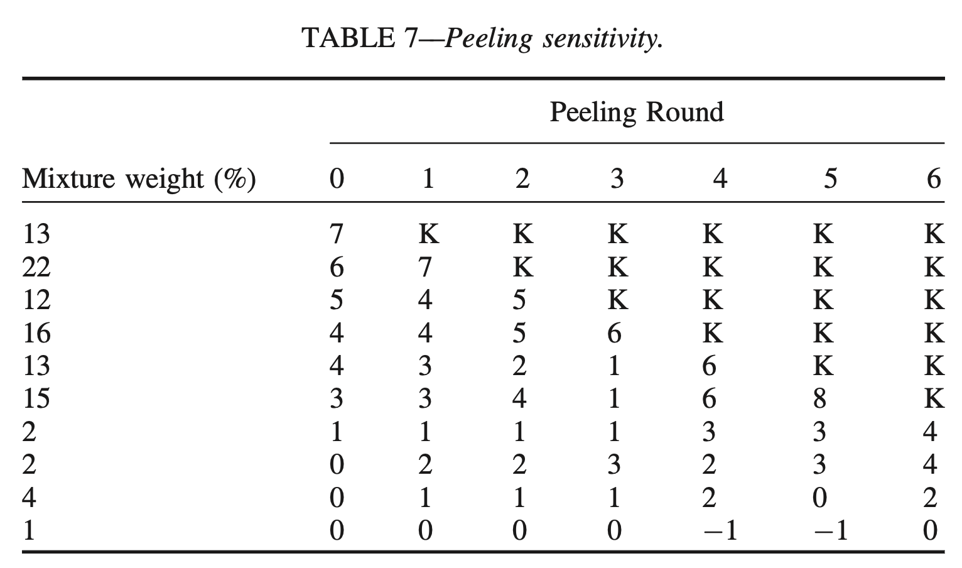
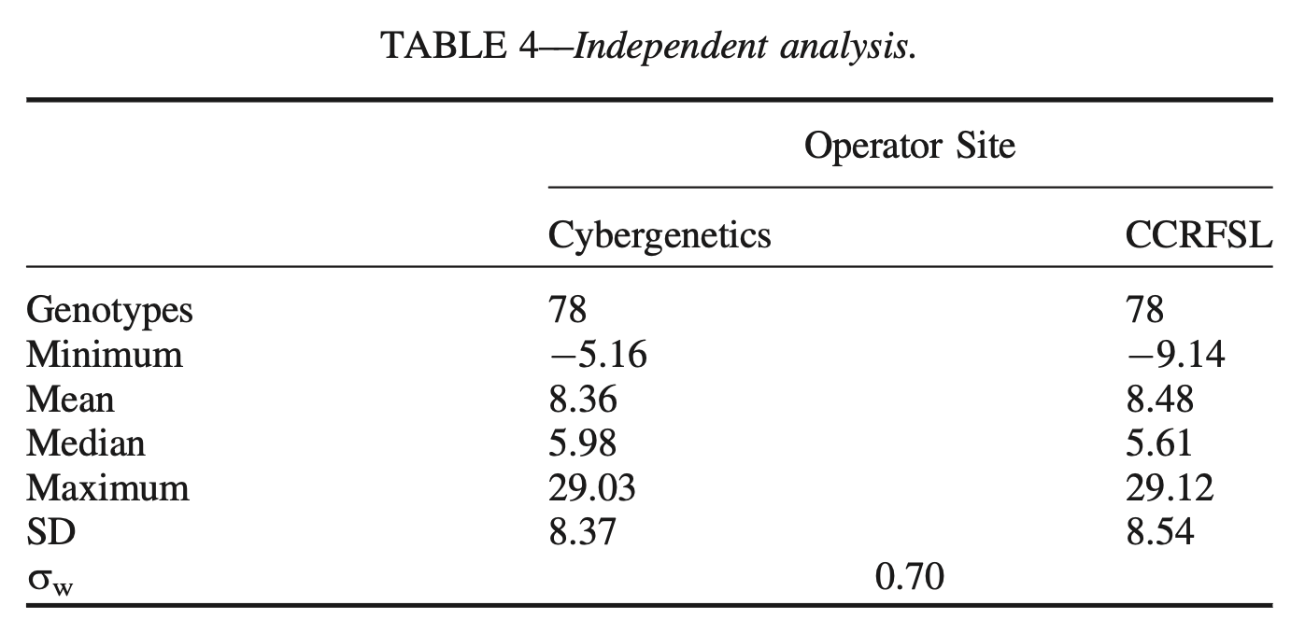
21

Slide 22
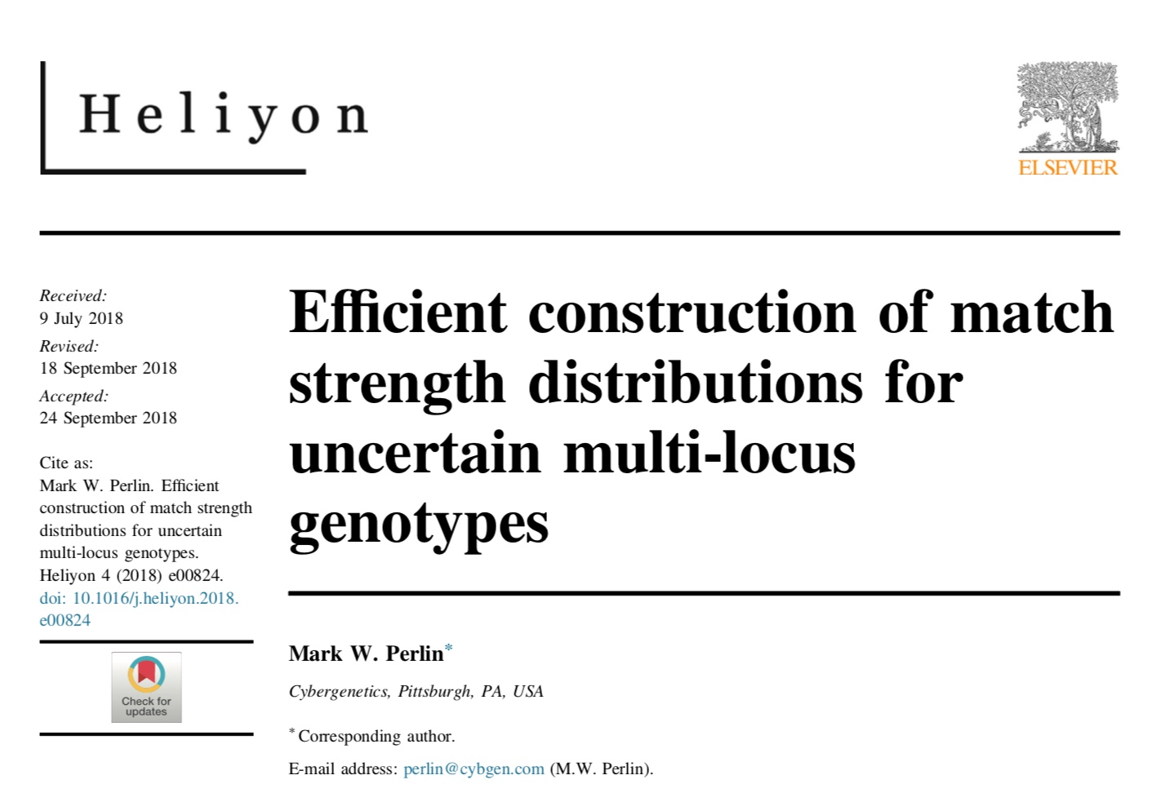
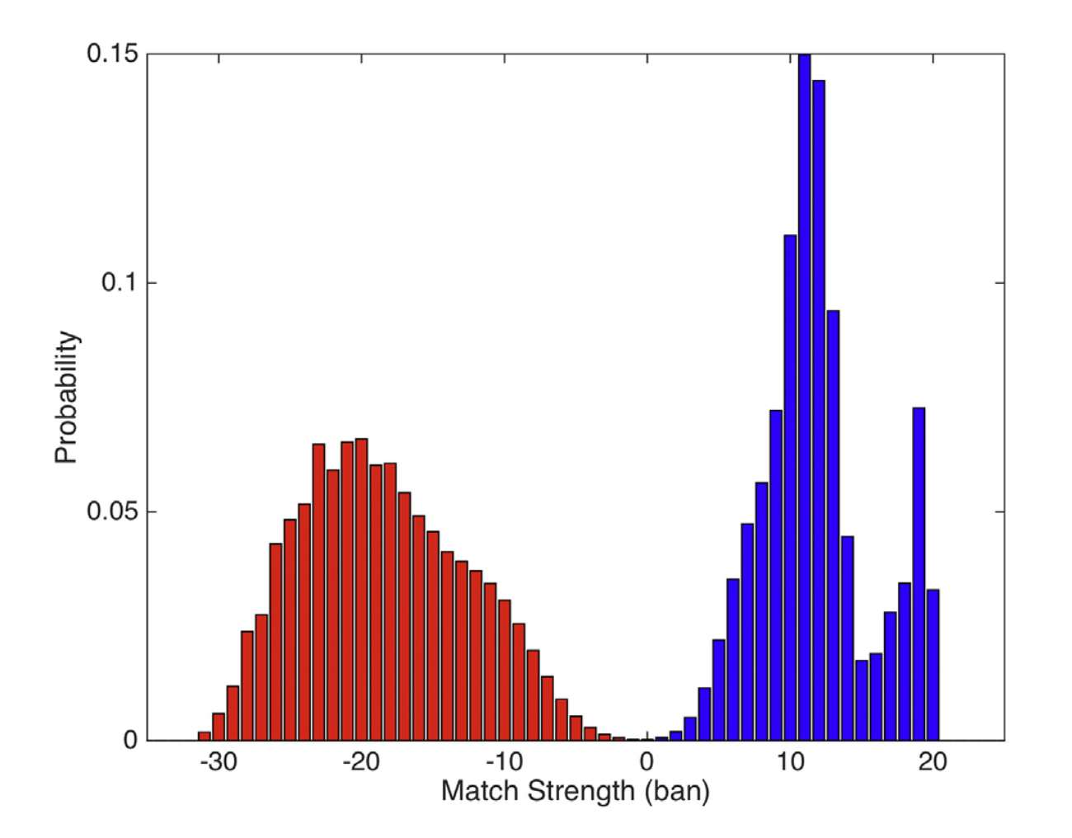
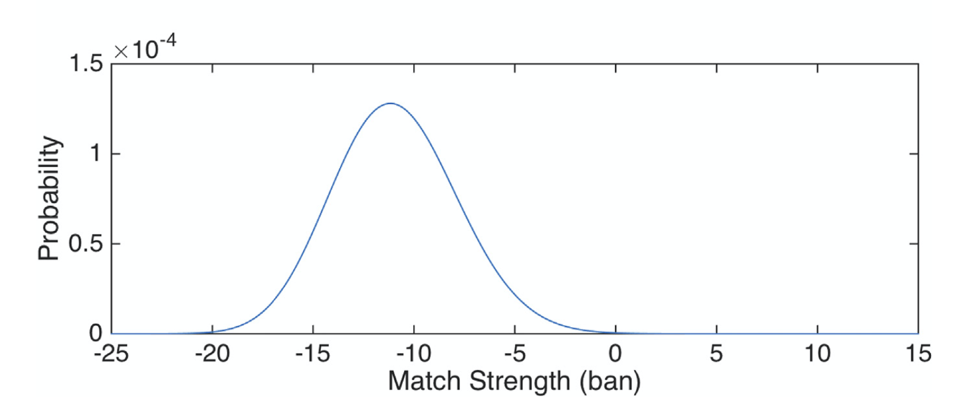
22

Slide 23
47 US admissibility rulings
23
Commonwealth of Pennsylvania v Kevin Foley (admitted, 2009; appellate precedent, 2012)
People of California v Dupree Langston (admitted, 2013)
Commonwealth of Virginia v Matthew Brady (admitted, 2013)
State of Ohio v Maurice Shaw (admitted, 2014)
State of Louisiana v Chattley Chesterfield & Samuel Nicolas (admitted, 2014)
People of New York v John Wakefield (admitted, 2015; appellate precedent, 2019; high court precedent, 2022)
State of South Carolina v Jaquard Aiken (admitted, 2015)
Commonwealth of Massachusetts v Heidi Bartlett (admitted, 2016)
State of Indiana v Dugniqio Forest (admitted, 2016)
State of Indiana v Malcolm Wade (admitted, 2016)
State of Washington v Emanuel Fair (admitted, 2017)
State of Louisiana v Harold Houston (admitted, 2017)
State of Indiana v Randal Coalter (admitted, 2017)
State of Nebraska v Charles Simmer (admitted, 2018; appellate precedent, 2019)
State of Indiana v Vaylen Glazebrook (admitted, 2018)
State of Ohio v David Mathis (admitted, 2018)
State of Florida v Lajayvian Daniels (admitted, 2018; appellate precedent, 2021)
State of Tennessee v Demontez Watkins (admitted, 2018; appellate precedent, 2021)
State of Georgia v Thaddus Nundra (admitted, 2019; appellate precedent, 2023)
State of Georgia v Monte Baugh & Thaddeus Howell (admitted, 2019)
State of Louisiana v Kyle Russ (admitted, 2019)
People of New York v Casey Wilson (admitted, 2019)
State of Georgia v Alexander Battle (admitted, 2019)
United States v Lenard Gibbs (admitted, 2019)
State of Georgia v Guy Sewell (admitted, 2019)
State of Georgia v Adedoja Bah (admitted, 2019)
State of Georgia v Nathaniel Day (admitted, 2019)
State of Tennessee v Abdullah Powell (admitted, 2021)
State of Georgia v Zarren Garner (admitted, 2021)
United States v Curtis Johnson, Jr. (admitted, 2021)
State of Georgia v Rahul Joseph Das (admitted, 2021)
State of Maryland v Tyrone Harvin (admitted, 2021; appellate precedent, 2024; writ of certiorari denied, 2025)
State of Maryland v Gregory Jones (not used, Daubert not applied, 2021)
State of Georgia v Lashumbia Session (admitted, 2021)
State of Georgia v Bryan Byers (admitted, 2022)
State of Louisiana v Dermell Lewis, Corey Major, & Gerald Parker (admitted, 2022)
State of Louisiana v James Tabb (admitted, 2022)
State of Louisiana v Shawn Briscoe and Lance McIntyre (not used due to timeliness, 2022)
United States v Hunter Anderson (admitted, 2023)
State of Louisiana v Corlious Dyson (admitted, 2023)
United States v Ravel Mills (admitted, 2023)
United States v Damond Lockett (admitted, 2023)
State of Georgia v Erin Stephon Arms (admitted, 2023)
State of Ohio v Michael Carter (admitted, 2024)
State of Georgia v Jose Ibarra (admitted, 2024)
State of Hawaii v Eric Thompson (admitted, 2024)
People of New York v Edward Holley (admitted, 2025)

Slide 24
TrueAllele today
24
Invented math & algorithms | 30 years
Developed computer systems | 25 years
Support users and workflow | 10 laboratories
Routinely used in casework | 535 agencies
Validate system reliability | 43 studies
Educate the community | 175 talks
Train or certify analysts | 400 students
Admissibility challenges | 45 rulings, 16 states and federal
Testify about LR results | 150 trials
Educate lawyers and public | 1,000 people
Make the ideas understandable | 1,300 cases, 47 states

Slide 25
Court ruling
25
The parties’ disagreement concerning the reliability of the evidence, as applied in this case, as well as any perceived flaws and weaknesses in TrueAllele, are issues to be tested through trial. For this court, the issues presented go to the weight of the evidence, rather than admissibility of the evidence. Although this court recognizes there TrueAllele is relatively new and “cutting edge” DNA technology, Defendant failed to demonstrate admission of the evidence would violate his right to due process.
Based on the foregoing, this court finds admission of the TrueAllele analysis and the conclusions generated through use of TrueAllele will not run afoul of Md. Rule 5-702, Md. Rule 5-403, the United States Constitution, or the Maryland Declaration of Rights.
Harvin was sentenced to life in prison for first-degree murder and rape

Slide 26
Appellate opinion
26
Appellant assertions
The TrueAllele parameters
Consistency between results and underlying data
Sufficiency of validation process
The calibration of the electrophoresis machine
Appellate Court decision
For the reasons articulated above, the circuit court did not abuse its discretion in admitting the TrueAllele evidence under Md. Rule 5-702.

Slide 27
Maryland Supreme Court
27
January 29, 2025
NOTICE OF ORDER
Tyrone Harvin v. State of Maryland
Petition No. 355, September Term, 2024
On January 29, 2025, the Court entered an order denying the petition for writ of certiorari in this Court.
TrueAllele appellate precedent in Maryland (7th state)

Slide 28

Conclusion
28
Cybergenetics invented TrueAllele technology 25 years ago
The world’s first reliable probabilistic genotyping software
TrueAllele separates mixture data into contributor genotypes
These contributor genotypes preserve identification information
Informative genotypes deliver accurate DNA match results
Separation turns mixtures into simple single-source-like genotypes
So TrueAllele results are easy to explain to judges and juries
Extensive validation established TrueAllele as reliable forensic science
TrueAllele is regularly admitted as reliable evidence after challenge
TrueAllele has appellate precedent in seven states: Florida, Georgia, Maryland, Nebraska, New York, Pennsylvania and Tennessee

